Slide 1


Slide 2
Infectious Diseases and
Oral Medicine
Dr. Najmeh Namazee
Infectious Disease Specialist

Slide 3
Outlines
Infections of the Oral Cavity, Neck, and Head
Infections in Oral Medicine According to Different Organisms
Sexually Transmitted Infections And Oral Medicine
HIV And Oral Medicine
Occupational Post Exposure Prophylaxis in HBV,HCV,HIV

Slide 4
Infections of the Oral Cavity, Neck, and Head

Slide 5
Infections of the oral cavity are most
commonly odontogenic in origin and include:
dental caries
periodontal disease
and
deep fascial space infections

Slide 6
Nonodontogenic infections of the oral cavity include :
infections of the oral mucosa
tonsils
epiglottis
supraepiglottic structures
and
infections of the major salivary glands

Slide 7
Miscellaneous infections of the head and neck
most commonly result from :
human or animal bites
irradiation
surgical procedures
arise from suppurative adenitis
infected embryologic cysts
suppurative thyroiditis

Slide 8
MICROBIOLOGIC CONSIDERATIONS
The microbiota associated with odontogenic
infections generally reflect the indigenous oral
microbiota and are typically polymicrobial:
  anaerobes
  facultative bacteria

Slide 9
Total cultivable oral microbiota
Greater than 80% of the oral microbiota:
  Streptococcus
  Finegoldia
  Peptostreptococcus
  Veillonella
  Lactobacillus
  Corynebacterium
  Actinomyces

Slide 10
Facultative gram-negative rods :
uncommon in healthy adults
but may be more prominent in
seriously ill patients
hospitalized patients
elderly patients

Slide 11
PATHOGENETIC MECHANISMS
Microorganisms that cause dental caries, such as
S. mutans and Streptococcus sobrinus
reside within the supragingival plaque
both acidogenic (able to produce acid) and aciduric (able to grow at low pH).

Slide 12
They readily colonize the tooth surface shortly after tooth eruption
but
Do not become cariogenic until they are exposed to dietary sucrose.

Slide 13
Fermentation of dietary sucrose by acidogenic plaque bacteria
lowers the pH on the tooth surface, promoting demineralization and eventually tooth decay.

Slide 14
CLINICAL MANIFESTATIONS
AND MANAGEMENT

Slide 15
Orofacial Odontogenic Infections
Odontogenic infections originate in either the dental pulp or the periodontium
The most common site is the dental pulp
The most common infections are dentoalveolar

Slide 16
Dentoalveolar Infections
Pulpal infection most frequently results from carious exposure, rarely from physical or chemical injury.
The carious process most frequently begins in pits and fissures on the occlusal surfaces of molars and premolars, in which food is likely to be retained.
The gingival margin are the next most common areas where the carious process begins.

Slide 17
Dento-alveolar Infections Process
Demineralization of the enamel results in discoloration
which is the first visible evidence of carious involvement.
Destruction of the enamel and dentin
Invasion of the pulp produce either localized or generalized pulpitis.
Drainage from the pulp is obstructed: pulpal necrosis
Invasion of the periapical areas : periapical abscess
Alveolar bone invasion: acute alveolar abscess

Slide 18
Treatment
The principles of treatment of dentoalveolar infections include prompt elimination of the infected pulp,
deep periodontal scaling, or extraction of the affected tooth.
Dentoalveolar abscess should be surgically drained at the same time.
Other supportive measures include hydration,
a diet of soft foods, analgesics, and oral hygiene.

Slide 19
Antibiotic therapy is indicated primarily if:
drainage cannot be adequately established
Or
when infection has perforated the cortex and spread into surrounding soft tissue.

Slide 20
Gingivitis and Periodontal Infections

Slide 21
Gingivitis
Acute and chronic inflammation of the gingiva is initiated by local irritation and microbial invasion associated with subgingival plaque.

Slide 22
In simple gingivitis, there is a bluish-red discoloration, with swelling
and thickening of the free gingival margin
A tendency for the gums to bleed after eating or toothbrushing may be one of the earliest findings.
There is usually no pain, but a mild fetor oris may be noticed

Slide 23
Aucte necrotizing ulcerative gingivitis
known as Vincent angina or trench mouth
The patient typically experiences:
a sudden onset of pain in the gingiva that interferes with normal mastication.
Necrosis of the gingiva occurs mainly in the interdental papilla and results in a marginated, punched-out, and eroded appearance.
A superficial grayish pseudomembrane is formed, and a characteristic halitosis with altered taste
Fever, malaise, and regional lymphadenopathy are
usually associated.

Slide 24
Treatment
local debridement
Lavage with oxidizing agents, which usually alleviates pain within 24 hours.
Antibiotic therapy with penicillin or metronidazole is indicated and is
highly effective during the acute phase of infection.

Slide 25
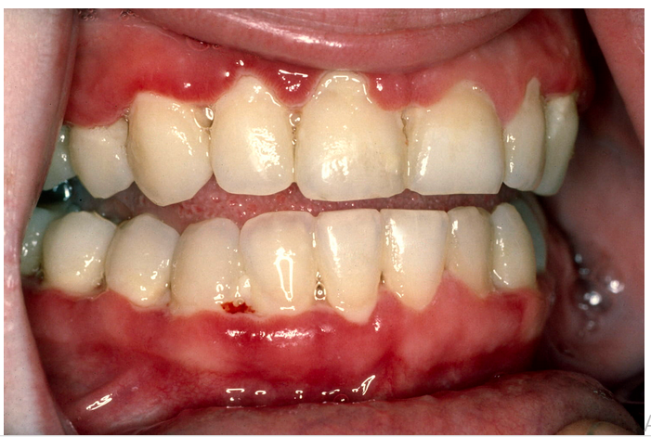
Trench mouth

Slide 26
Periodontitis
Chronic inflammation of the periodontium is the major cause of tooth loss in adults
Unlike pulpal infection, in which drainage is frequently obstructed, periodontal infections drain freely, and affected patients experience little or no discomfort.

Slide 27
Metronidazole, 500 mg PO or IV q8h
or
Amoxicillin-clavulanate, 500 mg PO q8h
or
Ampicillin-sulbactam, 1.5–3 g IV q6h
or
Clindamycin, 450 mg PO q6h or 600 mg IV q6–8h

Slide 28
Metronidazole (250 mg 3 times a day) is a common first drug choice due to its activity against anaerobes.
Penicillin, tetracyclines, clindamycin, amoxicillin, and amoxicillin with clavulanate have been shown to produce "acceptable" results
Topical antimicrobials are not recommended.

Slide 29
Periodontal Abscess
Periodontal abscesses may be focal or diffuse and manifest as :
red, fluctuant swelling of the gingiva, which is extremely tender to palpation.
Treatment is surgical and aimed at drainage of loculated pus

Slide 30
Pericoronitis
Pericoronitis is an acute localized infection associated with gum flaps overlying a partially erupted or impacted wisdom tooth.

Slide 31
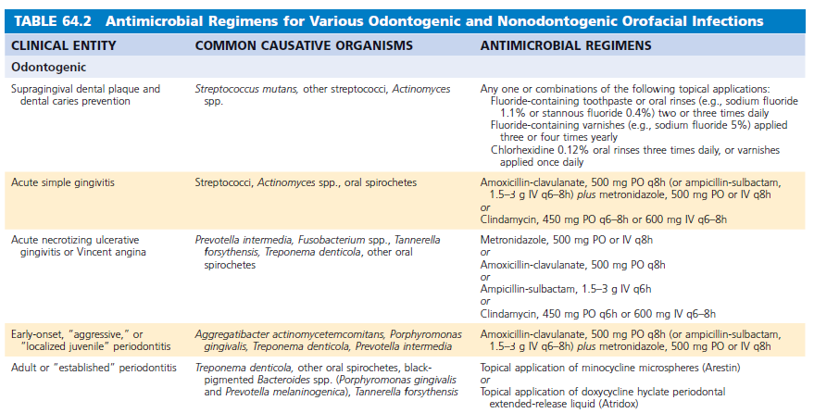

Slide 32
Deep Fascial Space Infections

Slide 33
Infections of either odontogenic or oropharyngeal origin may extend to:
Potential fascial spaces of the lower part of the head
Upper portion of the neck

Slide 34
These “space infections”:
  Those around the face (masticator, buccal, canine, and parotid spaces);
  Those in the suprahyoid region (submandibular, sublingual, and lateral pharyngeal spaces);
  Those involving the infrahyoid region or the total neck (retropharyngeal, danger, and pretracheal spaces)

Slide 35
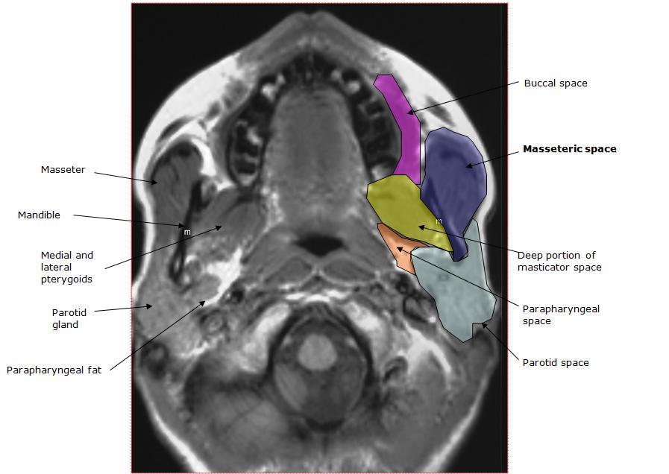
Deep Facial Spaces

Slide 36
Ludwig angina
infections involving the sublingual, submaxillary, and submandibular spaces.
classic description:
  (1) The infection is always bilateral
  (2) both the submandibular and sublingual spaces are
  involved
  (3) the infection is a rapidly spreading indurated cellulitis
  without abscess formation or lymphatic involvement
  (4) the infection begins in the floor of the mouth

Slide 37
The second and third mandibular molars are most commonly involved
Clinically, affected patients have a brawny, boardlike swelling in the submandibular spaces that does not pit on pressure
They usually hold their mouths open, and the floor is elevated

Slide 38
Treatment
Amoxicillin-clavulanate, 500 mg PO q8h
(or ampicillin-sulbactam, 1.5–3 g IV q6–8h)
plus
metronidazole, 500 mg PO or IV q8h
or
Clindamycin, 600 mg IV q6h
or
Cefoxitin, 1–2 g IV q6h

Slide 39
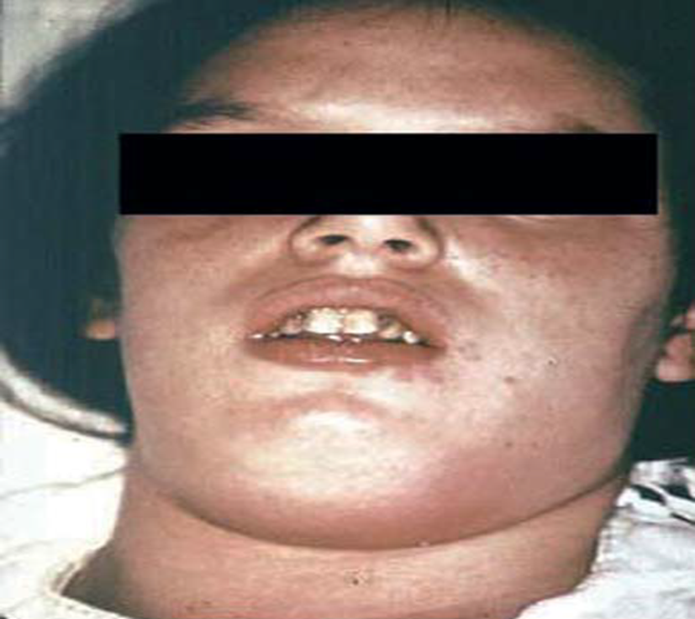
Ludwig angina

Slide 40
Complications of Odontogenic Infections

Slide 41
Suppurative Jugular Thrombophlebitis (Lemierre Syndrome)
Extension of infection to the carotid sheath, which encloses both the internal jugular vein and the internal carotid artery
Usually arises from the lateral pharyngeal space.

Slide 42
Sign and Symptoms
Acute onset
Shaking chills
Spiking fevers
Profound prostration

Slide 43
Pain and swelling at the angle of the jaw
Tenderness and induration along the sternocleidomastoid muscle
Swelling of the lateral pharyngeal wall
Neck rigidity
Dysphagia
Dysphonia

Slide 44
Systemic evidence of infection includes :
Septic pulmonary emboli
Metastatic abscesses to the brain, lungs, kidneys, and joints
Empyema

Slide 45
Contrast medium–enhanced CT may reveal the normal carotid artery and an enlarged jugular venous wall surrounding a more lucent intraluminal clot
Thrombosis of the jugular vein can also be demonstrated by magnetic resonance angiography (MRA)
The organisms most frequently involved are Fusobacterium necrophorum, anaerobic streptococci, and Bacteroides (now including Prevotella) spp.

Slide 46
Management
Most cases of suppurative jugular thrombophlebitis can be managed medically without the need for ligation or surgical resection of the infected vein.
Prolonged courses of intravenous (IV) antibiotics (3–6 weeks) are required.
Anticoagulants have sometimes been used in this
setting, but their efficacy is unconfirmed.
Surgical ligation of the internal jugular vein, the only available therapeutic option before antibiotics
were available, is now required only in the rare patient who fails to respond to antibiotic treatment alone

Slide 47
Osteomyelitis of the Jaws
The mandible is much more susceptible to osteomyelitis than is the maxilla
Because the cortical plates of the mandible are thin, and its medullary tissues have relatively poor vascular supply

Slide 48
There is usually a predisposing condition that affects host resistance
such as :
Compound fracture
Previous irradiation
Osteopetrosis
Paget disease
Diabetes mellitus
Steroid therapy

Slide 49
Osteomyelitis after dental extraction in irradiated bone is termed osteoradionecrosis.
Prior high-dose radiation from squamous cell carcinoma of the tongue or oral mucosa commonly
precedes osteoradionecrosis.

Slide 50
Chronic treatment with bisphosphonate
in cancer patients, women with osteoporosis, or patients with Paget disease can lead to a condition known as bisphosphonate-related osteonecrosis of the jaw (BRONJ)

Slide 51
A clinical variant is chronic sclerosing osteomyelitis associated with a proliferative periostitis
More common in children and young adults after a periapical infection of the mandibular first molar
It is a nonsuppurative form of osteomyelitis characterized by a localized, hard, nontender swelling over the mandible

Slide 52
On radiographs the newly formed periosteal bone looks like layers outside the cortex, with a characteristic “onion skin”appearance
Actinomycosis and radiation necrosis are two common causes of this form of osteomyelitisof the jaws with
“onion skin”appearance on radiographs

Slide 53
Orofacial Nonodontogenic Infections
Infections of the Oral Mucosa

Slide 54
Noma (Gangrenous Stoatmitis)
Also known as cancrum oris
Noma is an acute, fulminating, and gangrenous infection of the oral and facial tissues.
It usually occurs in the presence of severe debilitation and malnutrition, and children are most often affected.

Slide 55
The earliest lesion is a small, painful, red spot or vesicle on the attached gingiva in the premolar or molar region of the mandible.
A necrotic ulcer rapidly develops and undermines the deeper tissue.
Painful cellulitis of the lips and cheeks is observed as the lesion extends outward in a conelike manner. Within a short period,
Sloughing of necrotic soft tissues occurs and exposes underlying bone, teeth, and deeper tissues.

Slide 56
Treatment
Treatment of noma requires high doses of IV antibiotics
Correct the dehydration
Underlying malnutrition and debility
Loose teeth and sequestra may be removed, but saucerization should be avoided.

Slide 57
Ampicillin-sulbactam, 1.5–3 g IV q6–8h
or
Amoxicillin-clavulanate, 500 mg PO q8h
or
Clindamycin, 450 mg PO q6–8h or 600 mg IV q6–8h
Each plus metronidazole, 500 mg PO or IV q8h

Slide 58
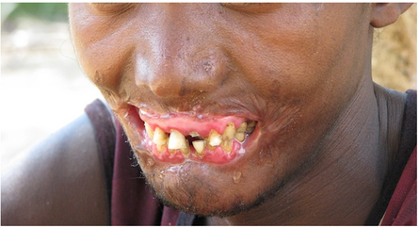
Noma(Gangrenous stomatitis)

Slide 59
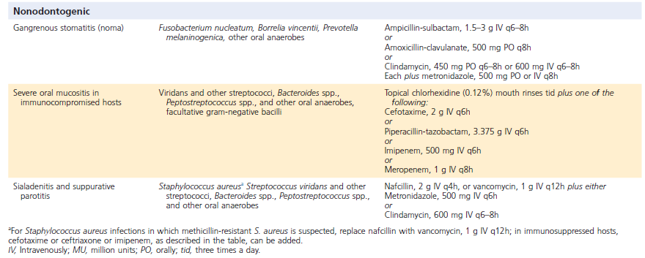

Slide 60
BACTERIAL INFECTIONS

Slide 61
Actinomycosis
Actinomyces spp. naturally colonize the oropharynx
gastrointestinal tract, and pelvis in humans

Slide 62
Clinical Presentation
Actinomycosis commonly occurs in the orocervical (50%), thoracic (20%), and abdominal pelvic regions (20%).
Over time, the infection will slowly erode through facial planes and develop chronic sinus tracts.
Most infections are thought to occur due to muscular injury, allowing the bacteria to penetrate into body areas and grow in an anaerobic environment

Slide 63
Diagnosis
Biopsy reveals classic gram-positive filamentous bacteria
Actinomycosis can sometimes be cultured under
anaerobic conditions. (Difficult)
Other diagnostic approaches, such as:
immunohistologic, polymerase chain reaction (PCR), and serologic techniques, are generally not commercially available.

Slide 64
Treatment
Actinomycosis is treated with a prolonged course of systemic antibiotics with or without surgery.
Penicillin-based antibiotics
(penicillin, amoxicillin, amoxicillin-clavulanate)
are preferred.

Slide 65
Tuberculosis
TB is caused by Mycobacterium tuberculosis.
Individuals acquire TB by inhaling airborne particles from other infected people.
Once inhaled, TB proliferates inside of alveolar macrophages.
When enough macrophages are recruited, local complexes of enlarged lymph nodes can be seen on a chest
radiograph.
These are called “ghon complexes,” where TB can remain dormant for decades.

Slide 66
Patients who initially develop TB (also called the primary disease stage) generally have fevers and other
nonspecific symptoms.
Once primary TB symptoms resolve, patients are considered to have latent TB.
This means that they likely still have residual TB bacteria,
which can reactivate at some point later in life.
When reactivated, TB generally presents with a
chronic respiratory infection with cough, fevers,
night sweats, and weight loss.
Patients classically have an upper lobe cavitary lesion on
chest radiographs.

Slide 67
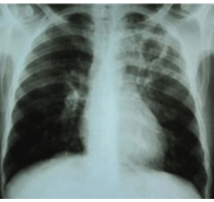
Upper lobe Cavity in Chest X-ray of a Patient with Pulmonary Tuberculosis

Slide 68
Diagnosis
Active TB is generally diagnosed via culture of the bacterium.
To improve the test sensitivity, serial sampling of respiratory tract specimens is common.
Special acid-fact bacteria (AFB) stains can aid in diagnosis, but these are nonspecific.
Newer PCR-based platforms are often used in conjunction with standard AFB stains and culture

Slide 69
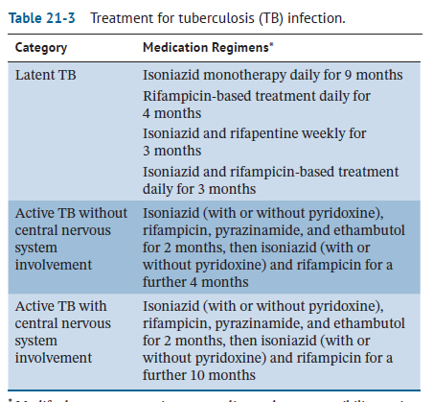

Slide 70
Prevention
Standard fluid-resistant masks likely provide some protection against TB for dental healthcare personnel.
Routine dental care should be deferred in patients who remain contagious with TB.

Slide 71
In the United States, patients with TB are no longer considered contagious if they meet the following criteria:
(1) three consecutive negative AFB sputum smears collected at 8–24-hour intervals;
(2) compliant with an adequate treatment regimen for at least two weeks; and
(3) improvement in symptoms

Slide 72
If oral care must be provided for a patient who is contagious with TB, patients should be placed in a negative pressure room
And
Healthcare workers should wear an N95-,
FFP2-, or FFP3-level respirator.

Slide 73
FUNGAL
INFECTIONS

Slide 74
Candidiasis:“Red and White Lesions of the Oral Mucosa.”
Other fungal infections can be divided into those that generally infect immunocompromised or immunocompetent patients.

Slide 75
Aspergillus, Rhizopus (mucromycosis), Fusarium, and Cryptococcus:
generally arise as opportunistic infections in immunocompromised patients

Slide 76
Other fungi such as :
Coccidioides immitis,
Histoplasma capulatum,
Blastomyces dermatitis,
Paracoccidioides brasiliensis,
and
dermatophytes
infect immunocompetent subjects

Slide 77
Mucormycosis
The term mucormycosis describes infections caused by the
class of fungi known as the mucorales.
Mucorales include Rhizopus, Mucor, and Lichtheimia (formerly Absidia)
The term “zygomycosis” has also been used for these infections.
These organisms are typically found in the soil and decaying
organic matter.
These fungi are highly pathogenic when identified in a sterile site.
In nonsterile sites they can be cultured from the human nose, throat, and oral cavity of healthy asymptomatic individuals.

Slide 78
Infection classically occurs in patients with decreased host resistance such as:
Diabetic ketoacidosis
Hematologic malignancies
Solid organ or bone marrow transplants
History of corticosteroid therapy
Graft-versushost disease
Patients with severe trauma or burns
Patients on deferoxamine therapy
Premature neonates

Slide 79
Mucormycosis is characterized by arterial invasion and a fulminant course, frequently resulting in death.
The hallmark of infection is the formation of emboli, with resulting necrosis of involved tissue.
Mucormycosis may present as a pulmonary,
sinus, rhinocerebral, skin, or disseminated
infection.

Slide 80
Clinical Presentation
The three most common forms of mucormycosis are
rhino-orbito-cerebral in diabetics
pulmonary in patients with hematologic malignancies or transplants
and infections from direct tissue inoculation related to combat or natural disasters.

Slide 81
Prevention
The judicious use of immunosuppressants like corticosteroids, and adequate control of diabetes, help in reducing the risk of infection
The use of rooms equipped with HEPA filters and the use of masks for patients with severe immunosuppression
Posaconazole is used as a secondary preventative measure in patients expected to continuing to be immunosuppressed after completing the
therapy for mucormycosis

Slide 82
Diagnosis
Early diagnosis is essential for improved survival and
reduced morbidity from extension and dissemination of disease.
Biopsy for culture and direct examination should be performed.
The histopathology shows necrosis and nonseptate
hyphae, which are best demonstrated by a periodic acid–
Schiff stain or the methenamine silver stain.
Newer techniques of identification include the use of PCR
( not generally commercially available)

Slide 83
Treatment
First-line therapy consists of a combination of aggressive surgical debridement and antifungal therapy.
liposomal AmB is considered the drug of choice.
Second-line treatment includes azoles, specifically posaconazole and isavuconazole.
Echinocandins, such as caspofungin, are also sometimes used in combination with other antifungals
The mortality rate is 50–100% in spite of therapy

Slide 84
Oral/Facial Considerations
The most common symptoms of the rhinomaxillary form include
Proptosis
Loss of vision
Nasal discharge
Sinusitis
Palatal necrosis

Slide 85
The most common oral manifestation of mucormycosis is:
ulceration of the palate, which results from necrosis due to invasion of a palatal vessel.
The lesion is characteristically large, deep, and may lead to exposure of underlying bone.

Slide 86
Ulcers from mucormycosis have also been reported on the:
Gingiva, lip, and alveolar ridge.
The initial manifestation of the disease may be confused with pain from an odontogenic infection or conventional bacterial maxillary sinusitis

Slide 87
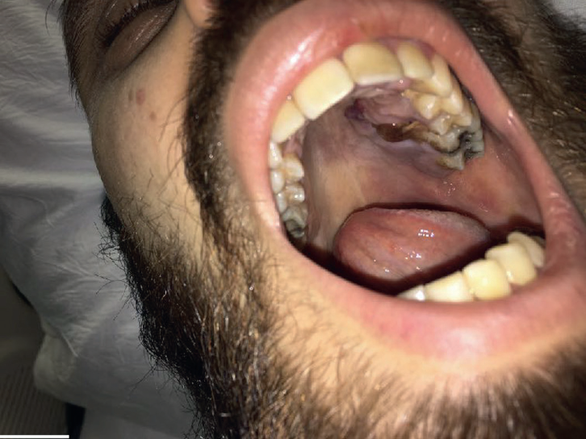
Mucormycosis in a patient with acute myelogenous leukemia

Slide 88
VIRAL
DISEASES

Slide 89
Varicella-Zoster Virus
Children who acquire VZV develop chickenpox, a diffuse rash.
Nonimmune adults who acquire VZV generally have a more severe presentation.
Chickenpox can lead to orofacial lesions such as vesicles over the facial skin and
the oral mucosa

Slide 90
Treatment
VZV infections can be treated with acyclovir and valacyclovir.
Antiviral therapy is not indicated for chickenpox in otherwise healthy individuals, but may be considered in:
Children 12 years or older
Patients with chronic cutaneous or pulmonary disease
Patients on short to intermittent courses of aerosol corticosteroids
Those on long-term salicylates

Slide 91
Prevention
Strict hand washing
Wearing of gloves
Vaccination of staff against VZV
is important in prevention of transmission of herpes virus in the clinical setting

Slide 92
Complications
Ramsay Hunt syndrome :
triad of ipsilateral facial paralysis, ear pain, and vesicles in the auricle.(Altered taste and oral lesions also occur)
Bell’s Palsy

Slide 93
Human Herpesvirus-6
The main mode of viral transmission is through contaminated saliva.
The primary infection is usually asymptomatic
and commonly occurs during childhood by age 2 years.
The clinical form is called exanthema subitum or roseala
infantum (also called sixth disease).
This biphasic disorder causing fever, then a maculopapular rash on subsidence of fever at the end of the
fourth febrile day.
Uvulo–palatoglossal junction ulcers are useful early signs.

Slide 94
The condition requires no antiviral treatment.
Recent reports have emphasized the critical role of
HHV-6 in the etiology of human oral SCC.
It is unclear whether the virus acts in combination with other carcinogens as a so-called co- carcinogen.
It can be detected using PCR or paired serologic testing.
HHV-6 can be treated with ganciclovir and foscarnet.

Slide 95
Human Herpesvirus-7
HHV-7 was first identified in 1990 and is closely related to HHV-6.
It establishes latency in macrophages and T lymphocytes
Reactivates frequently, with asymptomatic virus

Slide 96
Most children acquire infection by the age of 3–4 years
The spectrum of diseases caused by primary HHV-7 infection is similar to HHV-6, with milder clinical presentation.
Diagnostic testing for HHV-7 : PCR and serologic testing
Severe complications due to HHV-6 and -7 are treated
with ganciclovir and its derivatives, foscarnet, or cidofovir

Slide 97
Epstein–Barr Virus
EBV can cause local or systemic infections and benign or malignant diseases of the orofacial region.

Slide 98
Infectious mononucleosis or glandular fever,
Oral hairy leukoplakia
(OHL), a white patch on the side of the tongue with a hairy appearance
Malignancies such as lymphomas
(non-Hodgkin and Burkitt)
Nasopharyngeal carcinoma

Slide 99
Clinical features of infectious mononucleosis are
pharyngitis,
Cervical lymphadenopathy
Generalized arthromyalgia
Associated fever and malaise
Symptomatic treatment is indicated such as antipyretics, analgesics, and anti-inflammatories,
with no specific antiviral drug treatment.

Slide 100
Human Herpesvirus-8
HHV-8 is associated with Kaposi sarcoma, which is most commonly found in patients with HIV disease or AIDS.
HHV-8 is also called Kaposi sarcoma Herpesvirus (KSHV)
KS infection in non-HIV patients is rare and is classically associated with older males of Mediterranean decent.
KS seen in HIV disease or AIDS-associated KS is usually asymptomatic, with either purple or bluish macules or swellings affecting the orofacial skin and oral mucosae.

Slide 101
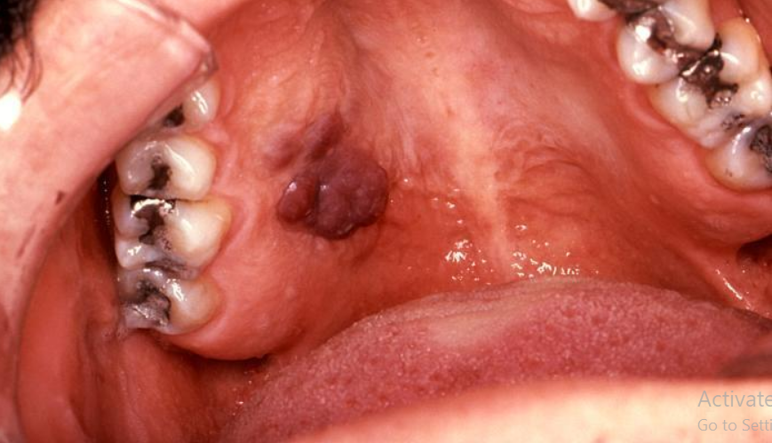
KS mucosal lesion

Slide 102
In the oral cavity, the hard palate is the most common site
Management may include intralesional injections
of cytotoxic drugs or sclerosing agents,
Surgery is warranted only to restore esthetics
Antiretroviral therapy (ART) has significantly
improved the management of orofacial KS associated
with AIDS.
Systemic chemotherapy is used in patients with
severe disease.

Slide 103
Mllouscum contagiosum
Large DNA virus.
Molluscum is primarily a disease of childhood.
The clinical presentation includes asymptomatic, multiple
flesh-colored, dome-shaped papules of the skin with a central
depression.
Lesions generally resolve in a few months.
patients who are immunocompromised are more prone
to develop severe disease.
The diagnosis is typically clinical.
Treatments include physical destruction
of the lesions with cryotherapy or curettage.

Slide 104
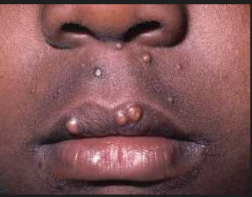
Mllouscum contagiosum

Slide 105
Coronaviruses
Two genera of coronavirus, α and β, infect humans.
Alpha coronaviruses are one of the causes of the common cold.
Beta coronaviruses include several important human pathogens, including the Middle East respiratory syndrome coronavirus (MERS-CoV) and
severe acute respiratory syndrome coronavirus (SARSCoV- 1 and SARS-CoV-2).
Notes:
several important human pathogens, including the Middle
East respiratory syndrome coronavirus (MERS-CoV) and
severe acute respiratory syndrome coronavirus (SARSCoV-
1 and SARS-CoV-2).

Slide 106
MERS-CoV, a novel zoonotic infection that likely originated from camels, was first identified in 2012 in Saudi Arabia

Slide 107
SARS-CoV-1, a zoonotic infection that may have originated from palm civets, was first identified in Guandong Province in China in 2003.
Patients with SARS-CoV-1 also typically present with an influenza-like illness that can progress to pneumonia and death in approximately 15% of patients

Slide 108
SARS-CoV-2 is a zoonotic virus that likely originated in bats in Wuhan, China at the end of 2019.129 Coronavirus disease
2019 (COVID-19) is the name of the clinical syndrome for patients infected with SARS-CoV-2.
COVID-19 often present with influenza-like illness symptoms, with fevers, cough, fatigue, and myalgia.
Other presentations include anosmia, dysgeusia, and diarrhea.
A substantial proportion of patients may
have no symptoms at all.

Slide 109
The virus is primarily transmitted via respiratory droplets.
Aerosols and surfaces are other potential additional sources of transmission.

Slide 110
Respirators (e.g.,N95) continue to be recommended by the CDC during aerosol-
generating procedures and during procedures in the nose, throat, oropharynx, and respiratory tract.

Slide 111
Dentistry is classified as one of the highest-risk professions
for transmitting COVID-19.
Dentists should wear the following personal protective equipment:
FFP3 (Europe) or N95 (USA) respirator.
Disposable gown.
Gloves.
Eye protection (goggles or face shield).

Slide 112
Current (2021) evidence-based treatments for COVID- 19 include remdesivir and dexamethasone.
Dozens of other agents are under active investigation

Slide 113
Vaccines against SARS-CoV-2
Inactivated viral product vaccines: Sinopharm
Protein-based vaccines: Pastocovac
Viral vector vaccines: Astrazeneca, Spotnic
Genetic vaccines: Moderna ,pfizer

Slide 114
short-lived passive immunization protection
has been developed using monoclonal antibodies

Slide 115
Congenital and Neonatal Viral Infections
Many organisms including viruses can infect the fetus
The responsible organisms have been widely known as TORCH: toxoplasma gondii, other
microorganisms, rubella virus, cytomegalovirus, and herpes
viruses.(TORCH)
Awareness of occupational health hazards such
as risk for pregnant female oral healthcare workers
and pregnant patients is important in preventing such crossinfection, though it is very rare

Slide 116

Thanks For Your Attention

