Slide 1


Slide 2
Sexually Transmited Infections of Oral Cavity
Dr. Najmeh Namazee
Infectious Disease Specialist

Slide 3
BACTERIAL INFECTIONS
  Chlamydia
  Gonorrhea
  Syphilis
Viral Infections
  Herpes viruses types 1&2
  Human Papilloma Virus
  Cytomegalovirus
  HIV
  HBV
  HCV(Rare)
Fungal Infections
  Candida

Slide 4
Chlamydia
Chlamydia is caused by Chlamydia trachomatis, an obligate intracellular gram-negative bacterium.
Chlamydia is the most reported STI worldwide

Slide 5
Clinical Presentation
Patients acquire chlamydia via vaginal, anal, or oral sex with an infected partner.
Causes genital infections in the cervix, urethra, or epididymis
Extragenital infections commonly present as pharyngitis and conjunctivitis
Due to breakdown of the mucosal barriers, patients are at greater risk of acquiring other STIs, including HIV

Slide 6
Diagnosis
Chlamydia trachomatis is generally diagnosed via nucleic acid amplification testing (NAAT) on cervical, ureteral, oral, rectal, or urinary specimens.

Slide 7
Treatment
Preferred antibiotics:
Doxycycline
Azithromycin

Slide 8
Gonorrhea
Gonorrhea is caused by Neisseria gonorrhoeae, a gram-negative bacterium.

Slide 9
Clinical Presentation
Gonorrhea infects the same anatomic sites as chlamydia, and symptoms between the two infections overlap.
Patients develop cervicitis, urethritis,
epididymitis, conjunctivitis, and pharyngitis.

Slide 10
Diagnosis and Treatment
Gonorrhea is diagnosed via NAAT
This can be performed in the urine and on swabs from the urethra, cervix, vagina, or oropharynx.
First-line therapy to treat gonorrhea is ceftriaxone
Recent increases in antimicrobial resistance to ceftriaxone have been observed
Gonorrhea damages mucous membranes, which increases the risk of HIV and other STIs

Slide 11
Syphilis
Syphilis is caused by Treponema pallidum, a spirochete bacterium
It is acquired primarily through sexual contact
Like chlamydia and gonorrhea, syphilis is
more common in younger individuals and MSM (Men have Sex with Men)

Slide 12
Clinical Presentation
Active syphilis infections can be divided into primary, secondary, and tertiary stages.
Primary infections occur within the first month of exposure.
Patients will present with a painless genital ulcer (chancre) at the initial inoculation site .
Some patients may not develop or recall developing an ulcer.

Slide 13
In secondary syphilis: patients develop a disseminated infection, which manifests as a diffuse rash (classically on the palms and soles).
In tertiary syphilis, which is very rare, patients present with a cardiovascular infection or a syphilitic gumma.
Syphilis may be passed from an infected mother to her child during pregnancy, causing congenital syphilis.
Patients with congenital syphilis may have deformed bones, severe anemia, jaundice, hepatomegaly, splenomegaly, blindness, deafness, meningitis, or skin rash.

Slide 14
Diagnosis
Syphilis is diagnosed using a combination of treponemal and nontreponemal tests

Slide 15
Treatment
Syphilis is treated based on the duration and severity of disease.
In general, early syphilis (<1 year) is usually treated with a single dose of intramuscular (IM) benzathine penicillin G.
Late syphilis (>1 year) is treated with IM penicillin once weekly for three consecutive weeks.
Patients who have evidence of neurologic involvement (neurosyphilis) require intravenous (IV) penicillin for 10–14 days

Slide 16
Herpes Simplex Virus
HSV1
HSV2

Slide 17
First episodes of HSV disease(oral and genital), especially primary infections:
Are frequently accompanied by systemic signs and symptoms
Involve both mucosal and extramucosal sites
Have a higher complication rate
Have a longer duration of symptoms
Have a longer viral shedding from lesions

Slide 18
Asymptomatic primary infection is common
Both viral subtypes can cause genital and orofacial infections
Infections caused by the two subtypes
are clinically indistinguishable.

Slide 19
In contrast to first episodes of genital infection, the symptoms, signs, and anatomic sites of infection of recurrent genital or orolabial herpes are usually localized to a defined mucocutaneous site

Slide 20
Spread of HSV-1 infection from oral secretions to other skin areas is a hazard of certain occupations (e.g., dentists, respiratory care
unit personnel)
Laboratory-acquired and nosocomial outbreaks in hospital or nursery personnel have been reported

Slide 21
immunocompromised patients and in moderate to severe infection: Oral or systemic acyclovir, 200 mg tablets, 5 times daily for 7 days or topical application of 5% acyclovir cream every 4 hours for 5 days is the recommended dose. Valacyclovir 1–2 g twice daily may be used for prophylaxis.

Slide 22
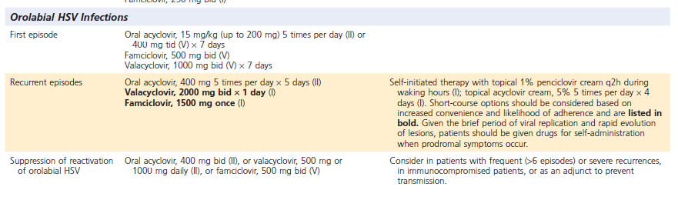

Slide 23
Complications of Oral Herpes Simplex
Virus Type 1
HSV-1 and VZV are implicated as common causes of Bell palsy
(facial paralysis of the mandibular portion of the facial nerve).
Antiviral therapy for Bell palsy suggest no benefit, perhaps related to the delayed timing of initiation of therapy.
Corticosteroids are a mainstay of therapy and correlate with improved short-term and long-term resolution of symptoms
A common regimen is prednisone, 60–80 mg/ day for 7 days
There is no consensus on use of antiviral agents plus corticosteroids versus corticosteroids alone for the treatment of Bell palsy.

Slide 24
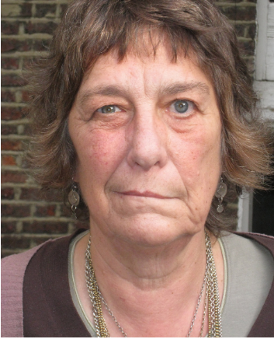
Bell’s Palsy

Slide 25
Human papillomavirus (HPV)
Double-stranded circular DNA viruses
Commonly found in the oral and oropharyngeal mucosa,tracheobronchial mucosa, and anogenital region.
Causes tumors that can be benign
or malignant

Slide 26
Transmission
Close personal contact, especially within the family and school class, is likely to be important for the transmission of most cutaneous warts.

Slide 27
Anogenital warts are sexually transmitted
The age of onset is similar to that in other sexually transmitted diseases (STDs)
The disease develops in approximately two-thirds of sexual contacts of patients with anogenital warts
Particular HPV types are associated with these lesions
These types are rarely found in lesions at other sites
Young children may acquire genital warts from hand contact with nongenital lesions.

Slide 28
The role of fomites in the transmission of HPV infection is uncertain.
Nosocomial transmission appears possible because infectious
Virus can be recovered from the fumes released from lesions during treatment with a carbon dioxide (CO2) laser or electrocoagulation.
HPVs are resistant to heat, and use of an autoclave is probably necessary for sterilization of contaminated instruments

Slide 29
Human Papillomavirus Infections in Oral Cavity
The oropharynx is now the most common site for the development of HPV-associated oral infections

Slide 30
Oral squamous cell papillomas (or squamous papillomas) are the most common HPV-related oral lesions.
oral condyloma acuminatum caused by mucosal HPV (mostly HPV-6, HPV-11, and HPV-16).
Oral verrucae vulgaris are rarer and can be differentiated reliably only with histology.
Focal epithelial hyperplasia of the oral cavity (Heck disease) tends to regress spontaneously.
Recurrent respiratory papillomatosis :in young children is acquired via passage through an infected birth canal or through the placenta.

Slide 31
The oral cavity should preferably be examined
in all patients with anogenital warts
because of the possibility of
concomitant oral warts.

Slide 32
HPV vaccines
Three HPV vaccines have been licensed.
Cervarix (GlaxoSmithKline, London, UK)
is directed against HPV-16 and HPV-18.
(Papilloguard vaccine is Iranian bivalent vaccine)
Gardasil (Merck, West Point, PA) is
directed at HPV-6, HPV-11,HPV-16, and HPV-18.
Gardasil 9, a nonavalent vaccine targets five additional high-risk HPV types—31, 33, 45, 52, and 58.

Slide 33
All the HPV vaccines were originally licensed for a three-dose schedule of immunization
0 - 1 to2 - 6 months vaccination
Several studies have shown that a two-dose
schedule is as effective and may be advantageous in resource-limited countries.
It is unknown at this time if beyond 5 years the two-dose schedule will remain effective or if a booster will be necessary.

Slide 34
Cytomegalovirus
CMV is known to cause mononucleosis-like disease
Characterized by pharyngitis, lymphadenopathy, and fever in a healthy immunocompetent individual
Requiring no specific therapy.
In the orofacial region, the mononucleosis-like disease
can present with palatal petechiae and submandibular
lymphadenopathy.
This virus also has been implicated in nonspecific oral ulcers and salivary gland disease, especially in HIV-infected patients.

Slide 35
CMV can be diagnosed via antibody testing, PCR, and histopathology
CMV can reactivate in immunocompromised patients and in any body tissues
CMV infections are generally treated with ganciclovir and valganciclovir

Slide 36
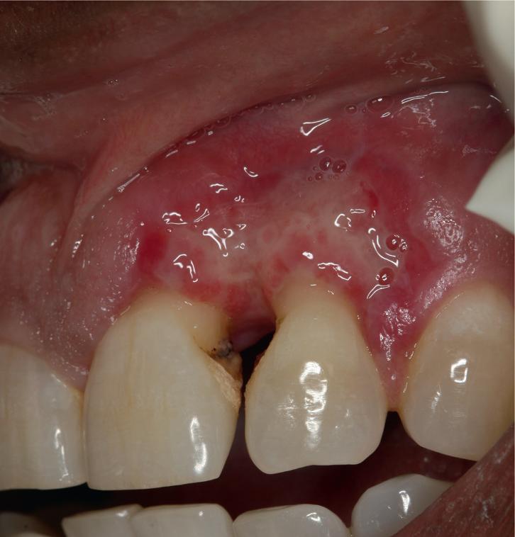
CMV lesion on the gingiva in HIV infected Patient

Slide 37
Hepatitis Virus
Hepatitis viruses cause inflammation of the liver known as
hepatitis.
Five main clinical types: hepatitis A (HAV), hepatitis B (HBV), hepatitis C (HCV), hepatitis D (HDV), and hepatitis E (HEV)
Out of the five, types B and C lead to chronic disease
HDV requires HBV for its replication,
hence it occurs as a super-infection or simultaneously(Co-infection) with HBV and can be chronic.
Sexual activities are thought to play a minor role in HCV
transmission

Slide 38
If a healthcare professional is infected, they must avoid patient care during the infectious stages with active signs and symptoms of the
disease.

Slide 39
Potential exposure to hepatitis virus in an oral health practice may include needle stick or other sharps injury,
Contact with potentially infectious body fluids, and
exposure to mucus membranes.

Slide 40
Candida
Oral candidiasis:most prevalent opportunistic infection of the oral mucosa
C. albicans, C. tropicalis, and C. glabrata comprise together over 80% of the species isolated from human mucosal candidal infections.

Slide 41
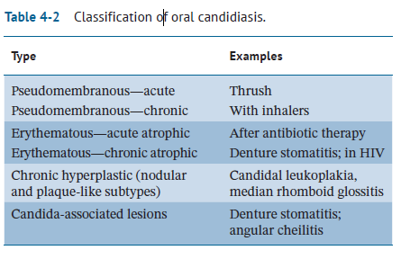

Slide 42
HIV and It’s Oral Manifestations

Slide 43
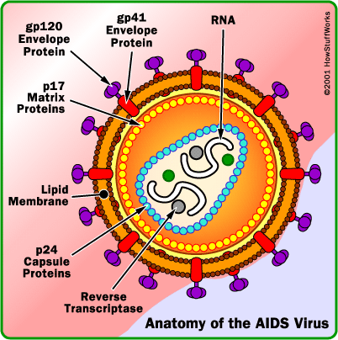
Human Immunodeficiency Virus
HIV is an RNA-based retrovirus that integrates into the DNA and replicates in a subset of T cells called CD4 cells.

Slide 44
CD4 cells help coordinate immune system responses.
HIV , if left untreated, the CD4 cell count will deplete over time, leaving individuals at risk for a variety of infections.
If the CD4 cell counts drop to very low levels, patients can develop a syndrome called acquired immunodeficiency syndrome (AIDS).

Slide 45
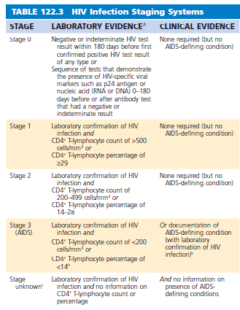

Slide 46
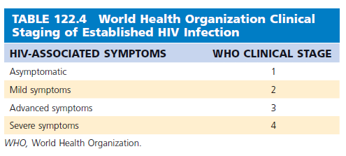

Slide 47
Oral Disease

Slide 48
Primary HIV infection has been associated with severe aphthous stomatitis and with oropharyngeal and esophageal candidiasis.
In the late stages of disease, oral manifestations are highly prevalent and frequently severe.

Slide 49
Oral Candidiasis
Candida infections of the hard and soft palates, buccal mucosa, tongue, pharynx, and hypopharynx are observed frequently.
The incidence of candidiasis increases with progressive cellular immunodeficiency, particularly as CD4+ counts fall below 200
to 300 cells/mm3

Slide 50
The most common form of candidiasis is thrush (pseudomembranous candidiasis)
Characteristic cottage cheese plaques that
can be removed with a tongue blade are seen on the soft palate, tonsils, and buccal mucosa
Less often, thrush involves the lateral and posterior aspects of the tongue, the hard palate, and the hypopharynx.

Slide 51
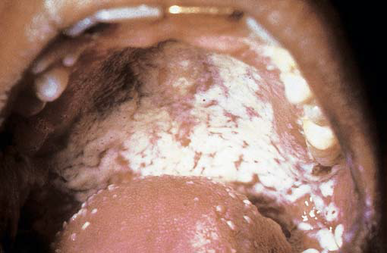
Oral candidiasis in a patient with HIV

Slide 52
Candida infection can produce flat erythematous plaques distributed in the same way as the pseudomembranous form of the disease but without the characteristic white exudate.
This atrophic form of candidiasis is underdiagnosed because many clinicians are unfamiliar with its appearance.
Atrophic candidiasis of the tongue also occurs.

Slide 53
Less frequently, Candida can cause a nonscrapeable white plaque similar to that seen in hairy leukoplakia.
In contrast to the corrugated lesions and hairlike projections seen in oral hairy leukoplakia, candidal lesions are smooth.
This hypertrophic form of disease may involve the lateral border of the tongue, palate, and buccal mucosa.

Slide 54
Candida infection of the lateral lip (angular cheilitis) is another common complication.
Angular cheilitis can cause pain, fissures, erythema,
and difficulty in opening the mouth.

Slide 55
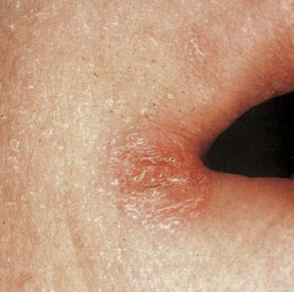
Angular Cheilitis

Slide 56
Diagnosis
Physical examination
Wet mount preparation (KHO smear)
Response to antifungal therapy
Cultures for Candida are rarely necessary unless antimicrobial resistance is suspected in patients with thrush refractory to azole therapy.
A biopsy specimen of oral lesions can be used to distinguish various forms of leukoplakia.

Slide 57
Oral Hairy Leukoplakia
Oral hairy leukoplakia is a raised white lesion of the oral mucosa that is usually seen on the lateral margin of the tongue.
The frequency of occurrence of oral hairy leukoplakia increases as the CD4+ count decreases.
Oral hairy leukoplakia appears to be caused by the replication of Epstein-Barr virus in the epithelium of keratinized cells on the surface
of the tongue and buccal mucosa.

Slide 58
The diagnosis is established by visual inspection, failure to scrape off the lesion with a tongue blade, failure of the lesion to respond to antifungal therapy, and biopsy material or scrapings in which Epstein-Barr virus can be identified.
Oral hairy leukoplakia is usually asymptomatic, although large lesions may impair taste, hinder eating, and cause discomfort.
There is usually clinical improvement with ART.

Slide 59
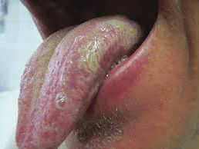
Oral Hairy Leukoplakia in a patient with HIV

Slide 60
Gingivitis and Periodontitis
Severe gingivitis (linear gingival erythema) and periodontitis (necrotizing
ulcerative periodontitis) have been observed in patients with HIV
disease.
Mixed cultures of aerobic and anaerobic flora have been obtained from gingival biopsy samples.
More severe, ulcerating gingivitis can be caused by infections with gram-negative bacilli, particularly Klebsiella pneumoniae and
Enterobacter cloacae.
Infections tend to be chronic, but debridement, irrigation, and topical antiseptic agents or metronidazole therapy may control some cases

Slide 61
Oral Ulcers
HSV types 1 and 2 may cause primary or recurrent
oral ulcers.
Episodes may last for several weeks;
Acyclovir may be beneficial.
CMV may rarely cause solitary large ulcers in patients with disseminated CMV infection.
Aphthous stomatitis is manifested by single or multiple painful ulcers, often with exudate or necrosis, which may appear on the buccal and
labial mucosa and lateral margin of the tongue
The ulcers may be treated with topical corticosteroids or thalidomide if persistent.

Slide 62
Other Oral Lesions
Kaposi sarcoma may occur at any site in the mouth, but the palate is most common.
Non-Hodgkin lymphoma may arise in the mouth as a swelling or ulcers; biopsy is required for diagnosis.
Oral warts caused by human papillomavirus infection may be seen, but they are not malignant precursors.
Ketoconazole and zidovudine can cause brown oral pigmentation.
Salivary glands such as the parotid gland may be enlarged by infiltration with CD8+ lymphocytes or benign lymphoepithelial cysts.

Slide 63

Thanks For Your Attention

