Slide 1
Halitosis (Breath Malodor)

Slide 2
Breath odor can be defined as the subjective perception after smelling someone’s breath.
It can be pleasant, unpleasant, or even disturbing, if not repulsive.
(breath malodor, halitosis, bad breath)
The three main categories of halitosis are genuine halitosis, pseudohalitosis, and halitophobia.

Slide 3
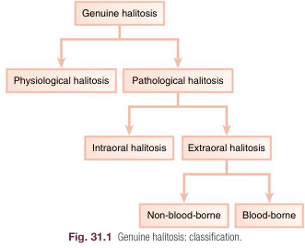
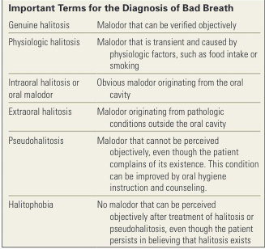

Slide 4
Etiology
In most patients, breath malodor originates from the oral cavity.
Tongue coating is the predominant cause of oral malodor.
periodontal diseases (gingivitis and periodontitis) are the second most important causative factors.

Slide 5
minority of patients (4% in the same study), extraoral causes could be identified, including
ear, nose, and throat (ENT) disorders,
systemic diseases (e.g., diabetes),
metabolic or hormonal changes,
hepatic or renal insufficiency,
bronchial and pulmonary diseases,
gastroenterologic disorders

Slide 6
Causes of Intraoral Halitosis
Tongue coating, poor oral hygiene, gingivitis, and periodontitis are the predominant causative factors.
It is the result of the degradation of by anaerobic bacteria. organic substrates
During the process of bacterial putrefaction, peptides and proteins present in saliva, food debris, gingival crevicular fluid, interdental plaque, shed epithelial cells, postnasal drip, and blood are hydrolyzed
to sulfide-containing and non–sulfide-containing amino acids, which can be further metabolized.

Slide 7
The proteolytic degradation of sulfur containing amino acids (cysteine, cystine, and methionine) by gram negative bacteria produces sulfur containing gases such as hydrogen sulfide (H2 S) and methylmercaptan (CH3 SH).

Slide 8
for oral malodor, the unpleasant smell of the breath mainly originates from VSCs, especially hydrogen sulfide, methylmercaptan, and (less significantly) dimethyl sulfide (CH3 )2 S.
Other compounds, such as the diamines )indole and skatole(, the polyamines )putrescine and cadaverine(, and the carboxylic acids )acetic, butyric, and propionic acid(, are also formed by proteolytic degradation of non sulfur containing amino acids by oral microorganisms.

Slide 9
Tongue and Tongue Coating
The dorsal tongue mucosa, with an area of 25 cm2, has a very irregular surface topography.
The innumerable depressions in the tongue surface are ideal niches for bacterial adhesion and growth, sheltered from cleaning actions.
Moreover, desquamated cells and food remnants also remain trapped in these retention sites and consequently can be putrefied by the bacteria.
coating on the tongue dorsum: Accumulated food remnants+ bacteria+ exfoliated cells

Slide 10
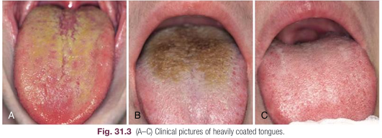
Research has shown that the strongest determinant of the presence of tongue coating is suboptimal oral hygiene.
Other influencing factors were periodontal status, presence of a denture, smoking, and dietary habits.

Slide 11
Periodontal Infections
A relationship between periodontitis and oral malodor has been shown.
Bacteria associated with gingivitis and periodontitis are able to produce VSCs.
Several studies have shown that VSC levels in the mouth correlate positively with the depth of periodontal pockets the deeper the pocket, the more bacteria, particularly anaerobic species
the amount of VSCs in the breath increases with the number, depth, and bleeding tendency of the periodontal pockets.
VSCs aggravate the periodontitis process by increasing the permeability of the pocket and mucosal epithelium, therefore exposing the underlying connective tissues of the periodontium to bacterial metabolites.

Slide 12
Other relevant malodorous pathologic manifestations of the periodontium are pericoronitis (the soft tissue “cap” being retentive for microorganisms and debris), major recurrent oral ulcerations, herpetic gingivitis, and necrotizing gingivitis-periodontitis.
Microbiologic observations indicate that ulcers infected with gram negative anaerobes (e.g., Prevotella and Porphyromonas spp.) are significantly more malodorous than noninfected ulcers.

Slide 13
Dental Disorders
Possible causes within the dentition are deep carious lesions with food impaction and putrefaction, extraction wounds filled with blood clots, and purulent discharge leading to important putrefaction.
Other causes include interdental food impaction in large interdental areas and crowding of teeth, favoring food entrapment and accumulation of debris.
Acrylic dentures, especially when kept continuously in the mouth at night or not regularly cleaned, can lead to infections (e.g., candidiasis), which produce a typical smell.

Slide 14
Dry Mouth
Saliva has an important cleaning function in the oral cavity.
Patients with xerostomia often present with large amounts of plaque on teeth and extensive tongue coating.
The increased microbial load and the escape of VSCs when salivary flow is reduced explain the strong breath malodor.

Slide 15
Extraoral Causes
Extraoral halitosis can be subdivided into two types:
non blood borne halitosis
blood borne halitosis.
Blood borne halitosis is the result of bad smelling metabolites that can be formed or absorbed at any place in the body (e.g., liver, gut) and transported by the bloodstream to the lungs.
Exhalation of these volatiles in the alveolar air then causes halitosis,

Slide 16
The extraoral causes are much more difficult to detect, although they can sometimes be recognized by a typical odor.
Uncontrolled diabetes mellitus can be associated with a sweet odor of ketones, liver disease can be revealed by a sulfur odor,
kidney failure can be characterized by a fishy odor because of the presence of dimethylamine and trimethylamine.

Slide 17
Ear, Nose, and Throat
During chronic or purulent tonsillitis, the deep crypts of the tonsils accumulate debris and bacteria, especially periopathogens, resulting in putrefaction.
Acute pharyngitis (viral or bacterial) and postnasal drip.
Ozena (caused by Klebsiella ozaenae) is a rare atrophic condition of the nasal mucosa, with the appearance of crusts that cause a very strong breath malodor.

Slide 18
Bronchi and Lungs
Pulmonary causes of halitosis include chronic bronchitis, bronchiectasis (infection of standing mucous secretion in cystic dilations through walls of bronchioles), pneumonia, pulmonary abscess, bronchial carcinoma, and carcinoma of the lung.

Slide 19
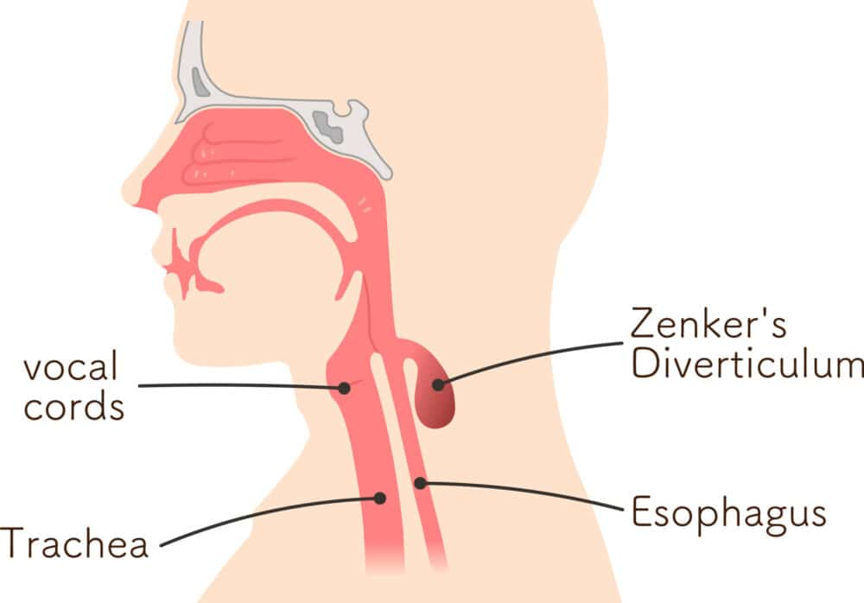
Gastrointestinal Tract
gastrointestinal disorders are rarely responsible for bad breath.
The following may be responsible for less than 1% of malodor cases:
A Zenker diverticulum
A gastric diaphragmatic hernia
Regurgitation esophagitis
Intestinal gas production

Slide 20
Liver
Patients with various degrees of hepatocellular failure and/or portosystemic shunting of blood may acquire a sweet, musty, or even slightly fecal aroma of the breath, termed fetor hepaticus, which has been mainly attributed to the accumulation of dimethyl sulfide.
Kidney
Kidney insufficiency, primarily caused by chronic glomerulonephritis, leads to an increase of the amines dimethylamine and trimethyl amine, causing a typical fishy odor of the breath.

Slide 21
Systemic Metabolic Disorders
Uncontrolled diabetes mellitus results in the accumulation of ketones, which have a sweet smell, like the odor of rotten apples.
Insulin resistance leads to an increase of triglycerides and free fatty acids, and ketones (e.g., acetone, acetoacetate, hydroxybutyrate) are formed during lipolysis.

Slide 22
Hormonal Causes
At certain points during the menstrual cycle, a typical breath odor can develop; partners are often aware of this odor.
Evidence also indicates that VSC levels in the expired air are increased twofold to fourfold around the day of ovulation and in the perimenstrual period.

Slide 23
Organoleptic Rating
organoleptic assessment by a judge is still the gold standard in the examination of breath malodor and therefore the most often used method.
In a specialized consultation, the organoleptic evaluation is performed by one trained and preferably calibrated judges.
The judge sniffs the expired air and assesses whether it is unpleasant by using an intensity rating.

Slide 24
Scoring is normally done according to the intensity scale of Rosenberg, where
0 represents the absence of odor,
1 is a barely noticeable odor,
2 is slight malodor,
3 is moderate malodor,
4 is strong malodor,
5 is severe malodor

Slide 25
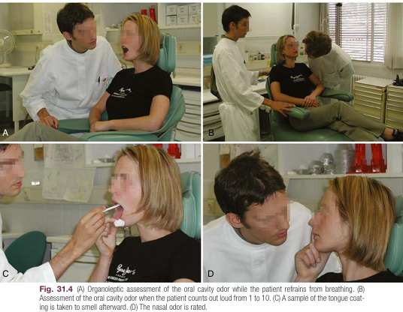
In an organoleptic assessment, the judge smells a series of air samples, as follows:
1. Nasal breath odor
2. Oral cavity odor (passive)
3. Oral cavity odor (active) (intraoral)
4. Tongue coating
subjective

Slide 26
Portable Volatile Sulfur Monitor
The Halimeter is an electronic device that detects the presence of VSCs such as hydrogen sulfide and methylmercaptan in the breath.
The instrument cannot discriminate among the different sulfur compounds.
The device is almost insensitive to dimethyl sulfide.
The patient has to keep the mouth closed for 3 minutes before sampling.
The mouth air is aspirated by inserting a drinking straw fixed on the flexible tube of the instrument.

Slide 27
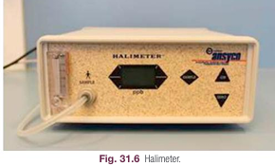
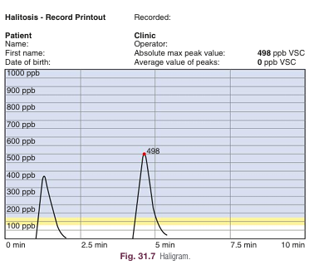

Slide 28
The Halimeter is easy to use as a chairside test and is less expensive than other portable devices.
Patients are usually less embarrassed by this examination than by an organoleptic assessment.
Moreover, the absence of odor in cases of halitophobia can be more convincingly proven than by an organoleptic assessment.

Slide 29
An important drawback of the device is that it detects only sulfur compounds and thus is useful only for intraoral causes of halitosis.
The absence of VSCs does not prove that no breath odor is present.
In patients with oral malodor, VSC concentrations can easily reach 300 to 400 ppb.

Slide 30
Gas Chromatography
A gas chromatograph can analyze air, saliva, and/or crevicular fluid.
The most important advantage of the technique is that when coupled with mass spectrometry, it can detect virtually any compound when using adequate materials and conditions.
Moreover, it has very high sensitivity and specificity.
Elaborate gas chromatography is available only in specialized centers but is especially useful for identifying nonoral causes.
However, it is expensive and requires trained personnel.

Slide 31
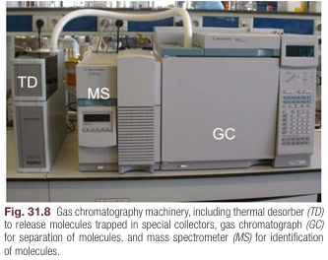

Slide 32
A small portable gas chromatograph has been introduced, which makes this technique available for periodontal clinics.
The OralChroma has the capacity to measure the concentration of the three key sulfur compounds hydrogen sulfide, methylmercaptan, and dimethyl sulfide separately.

Slide 33
This can be helpful for a differential diagnosis.
A high concentration of methylmercaptan compared with hydrogen sulfide indicates, for example, periodontitis.
If only hydrogen sulfide is increased, a problem with oral hygiene may exist.
Dimethyl sulfide can indicate an extraoral cause.
Just like the Halimeter, the OralChroma cannot detect compounds other than sulfur compounds, and some intraoral and extra oral causes can thus be overlooked.

Slide 34
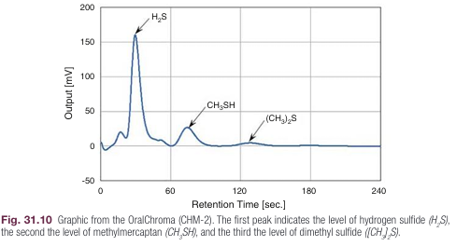

Slide 35
Treatment of Intraoral Halitosis or Oral Malodor
Because intraoral halitosis is caused by the metabolic degradation of available proteins to malodorous gases by certain oral microorganisms, the following general treatment strategies can be applied:
• Mechanical reduction of intraoral nutrients (substrates) and microorganisms
• Chemical reduction of oral microbial load
• Rendering malodorous gases nonvolatile
• Masking the malodor

Slide 36
Mechanical Reduction of Intraoral Nutrients and Microorganisms
tongue cleaning reduces both the amount of coating (and thus bacterial nutrients) and number of bacteria and thereby improves oral malodor effectively.
Cleaning of the tongue is best when performed before tooth brushing and can be done with a normal toothbrush, but preferably with a tongue scraper if a coating is established.
Tongue cleaning using a tongue scraper reduces halitosis levels by 75% after 1 week.

Slide 37
Tongue cleaning has the additional benefit of improving taste sensation.
Interdental cleaning and tooth brushing are essential mechanical means of dental plaque control.
The mechanical action of toothbrushing alone has no appreciable influence on the concentration of VSCs.

Slide 38
When chronic oral malodor arises as a consequence of periodontitis, professional periodontal therapy is needed.
A one stage, full-mouth disinfection, combining scaling and root planing with the application of chlorhexidine, reduced organoleptic malodor levels up to 90% in one study.
initial periodontal therapy had only a weak impact on VSC levels, except when combined with a mouthrinse containing chlorhexidine.

Slide 39
Chemical Reduction of Oral Microbial Load
Together with toothbrushing, mouthrinsing has become a common oral hygiene practice.
Formulations have been modified to include antimicrobial and oxidizing agents, affecting the process of oral malodor formation.
The active ingredients usually include antimicrobial agents such as chlorhexidine, cetylpyridinium chloride (CPC), essential oils, chlorine dioxide, triclosan, amine fluoride, stannous fluoride, hydrogen peroxide, and baking soda.
Some of these agents have only a temporary effect on the total number of microorganisms in the oral cavity.

Slide 40
Chlorhexidine
Chlorhexidine is considered the most effective antiplaque and anti gingivitis agent.
Its antibacterial action can be explained by disruption of the bacterial cell membrane by the chlorhexidine molecules, thus increasing its permeability and resulting in cell lysis and death.
Because of its strong antibacterial effects and superior substantivity in the oral cavity, chlorhexidine rinsing provides significant reductions in VSC levels and organoleptic ratings.
chlorhexidine at a concentration of 0.2% or higher also has some disadvantages, such as increased tooth and tongue staining, unpleasant taste, and some temporary reductions in taste sensation

Slide 41
Essential Oils
Listerine was found to be only moderately effective against oral malodor (±25% reduction vs. 10% for placebo of VSCs after 30 minutes) and caused a sustained reduction in the levels of odorigenic bacteria.
Chlorine Dioxide
Chlorine dioxide (ClO2) is a powerful oxidizing agent that can eliminate bad breath by oxidation of hydrogen sulfide, methylmer captan, and the amino acids methionine and cysteine.
Studies have demonstrated that a single use of a chlorine dioxide–containing oral rinse slightly reduced mouth odor.

Slide 42
Triclosan
a broad spectrum antibacterial agent, has been found to be effective against most oral bacteria and has good compatibility with other compounds used for oral home care.
an experimental mouthrinse containing 0.15% triclosan and 0.84% zinc (Zn2+) produced a stronger and more prolonged reduction in mouth odor than Listerine rinse.

Slide 43
Amine Fluoride and Stannous Fluoride
The association of amine fluoride with stannous fluoride resulted in encouraging reductions of morning breath odor, even when oral hygiene was insufficient.
Stannous fluoride has also been shown to be effective in the management of oral malodor as a component of a dentifrice, reducing both organoleptic scores and VSC levels.

Slide 44
Hydrogen Peroxide
Oxidizing Lozenges
Baking Soda
Baking soda dentifrices have been shown to confer a significant odor-reducing benefit for up to 3 hours.
The mechanism whereby baking soda produces its inhibition of oral malodor is related to its bactericidal effects.

Slide 45
Conversion of Volatile Sulfur Compounds
Metal Salt Solutions
Metal ions with an affinity for sulfur are efficient in capturing the sulfur containing gases.
Zinc is an ion with two positive charges (Zn2+), which will bind to the twice-negatively loaded sulfur radicals and thus reduce the expression of VSCs.
Clinically, the VSC inhibitory effect was copper chloride > stannous fluoride > zinc chloride (CuCl2 > SnF2 > ZnCl2 ).

Slide 46
Compared with other metal ions, Zn2+ is relatively nontoxic and gives no visible discoloration.
The most recent report on the effectiveness of zinc lactate containing mouthwash showed reduced organoleptic scores and VSC over a period of 3 hours in subjects in periodontal maintenance.

Slide 47
Masking the Malodor
Treatment with mouth rinses and sprays or lozenges containing volatiles with a pleasant odor has only a short term effect.
Typical examples are mint containing lozenges and the aroma of rinses without antibacterial components.
Another pathway is to increase the solubility of malodorous compounds in the saliva by increasing the secretion of saliva; a larger volume allows the retention of larger amounts of soluble VSCs.

