Slide 1
Gingival Enlargement and Management

Slide 2
Terminology and Classification
Gingival enlargement and gingival overgrowth are terms frequently and interchangeably used with hyperplasia, hypertrophy, and fibrosis.
Hyperplasia is an increase in the number of cells in tissues that results in increased tissue volume.
Hypertrophy refers to increased tissue size and volume resulting from increased cell size.
Fibrosis is a pathologic process in which aberrant wound healing is associated with defective cell proliferation, cell-to-cell interactions, cell-to-matrix interactions, matrix deposition.

Slide 3
Hyperplastic, hypertrophic, and fibrotic changes are observed during gingival enlargement and cannot be accurately differentiated.
Therefore, this chapter uses gingival overgrowth (GO) or gingival enlargement to refer to all pathologic forms in periodontal tissues.

Slide 4
Diagnosis
the degree of gingival enlargement can be scored as follows:
• Grade 0: no signs of gingival enlargement
• Grade I: enlargement confined to the interdental papilla
• Grade II: enlargement involves the papilla and marginal gingiva
• Grade III: enlargement covers three fourths or more of the crown

Slide 5
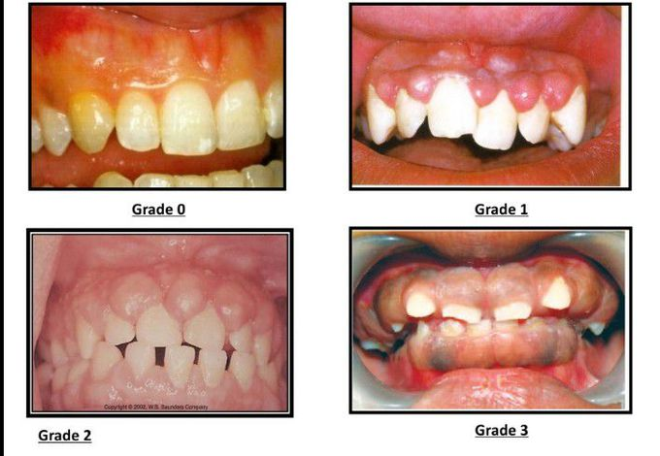

Slide 6
Types of Gingival Enlargement
Inflammatory Enlargement of Gingiva Due to Gingivitis
Drug Induced Overgrowth of Gingiva
Gingival Overgrowth Associated With Systemic Conditions
Pregnancy Associated Gingival Overgrowth
Puberty Associated Gingival Overgrowth
Nutrition Associated Gingival Overgrowth
Gingival Fibromatosis
Other Forms of Gingival Enlargement

Slide 7
Inflammatory Enlargement of Gingiva Due to Gingivitis (acute, chronic, Plasma cell gingivitis)
Clinical Manifestations
Clinical presentation of the gingivitis associated inflammatory gingival enlargement can be observed as a slight ballooning of the interdental papilla and marginal gingiva at its initial stages.
As it progresses, it involves swelling around the teeth, increasing in size until it covers part of the crowns.
Localized, generalized

Slide 8
Etiology
Acute forms of inflammatory enlargement of the gingiva are usually caused by mechanical trauma, chemical or physical irritation, and can be resolved by removing the irritant.
Mouth breathing, impacted food items, improperly placed or dislodged dental prostheses or appliances, and poor oral hygiene are usually responsible for acute inflammatory reactions in gingival tissues.
Acute lesions are typically localized to marginal or papillary gingiva.
Acute inflammatory enlargement can lead to the formation of a gingival abscess.
A gingival abscess is a localized, painful, rapidly expanding lesion.

Slide 9
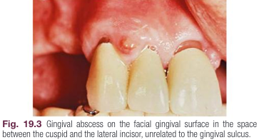
It is typically limited to the marginal gingiva or the interdental papilla.
In its early stages, it appears as a red swelling with a smooth, shiny surface.
The lesion usually becomes fluctuant and pointed, with a surface orifice and a purulent exudate in 24 to 48 hours.
Adjacent teeth may become sensitive to percussion
The lesion usually ruptures spontaneously.

Slide 10
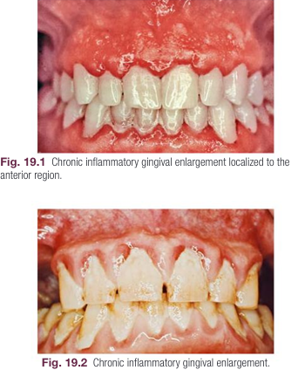
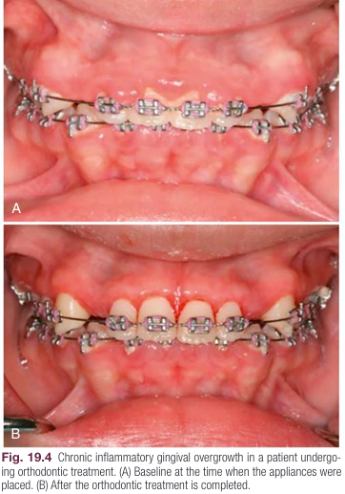
Chronic inflammatory GO is associated with microbial biofilm.
The biofilm can be linked to a lack of proper oral hygiene, orthodontic appliances, faulty restoration margins, misaligned teeth, oral habits, an open bite,…

Slide 11
Chronic gingivitis associated GO is often seen in patients who are mouth breathers.
The gingiva appears red and edematous, with a diffuse surface shininess of the exposed area.
The maxillary anterior region is commonly involved.
The pathogenesis of mouth breathing associated gingival changes is far more complex.

Slide 12
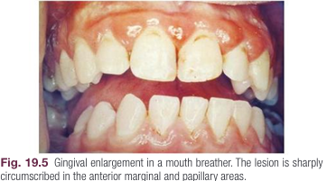

Slide 13
Plasma cell gingivitis
it is unclear whether this form of GO is a distinct disease.
It manifests as a mild marginal gingival enlargement that extends to the attached gingiva; the gingiva appears red, friable, and sometimes granular.
It bleeds easily, and pseudopockets may be present, clinically indistinguishable from common forms of chronic gingivitis associated GO except for its localization.
Plasma cell gingivitis was thought to be allergic in origin and possibly a reaction to chewing gum components, dentifrices, or various dietary items.

Slide 14
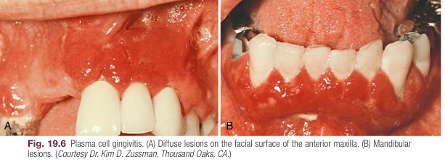

Slide 15
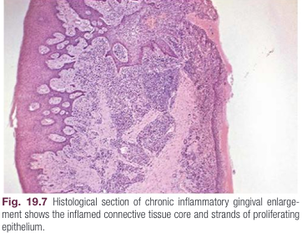
Histopathology
Chronic inflammatory GO lesions show the exudative and proliferative features of chronic inflammation.

Slide 16
exudative: Deep red or bluish red lesions are soft and friable with a smooth, shiny surface that bleeds easily.
They also have a preponderance of inflammatory cells and fluid, along with vascular engorgement, new capillary formation, and associated degenerative changes.
Proliferative: Lesions that are relatively firm, resilient, and pink have a greater fibrotic component, with an abundance of fibroblasts and collagen fibers.

Slide 17
Treatment
Chronic enlargement of the gingiva due to gingivitis is reversible and can be resolved by removing the etiologic factors, including controlling the biofilm and any contributing environmental factors.
In severe forms of inflammatory enlargement, surgical approaches may be required.

Slide 18
Drug Induced Overgrowth of Gingiva
The most common forms of DIGO are caused by anticonvulsants, calcium channel blockers, and immunosuppressants prescribed to manage serious conditions.
Three drugs associated with DIGO are phenytoin, nifedipine, and cyclosporine.
An estimated 30% to 80% of the patients using various medications are at risk for overgrowth lesions.
Genetic factors, drug dosage, and local factors can affect the development and severity of DIGO.
It frequently results in impaired oral hygiene, biofilm accumulation, and gingival inflammation.

Slide 19
The first signs of overgrowth can be observed as early as 3 months of drug use as a localized nodular enlargement of the interdental papilla.

Slide 20
Anticonvulsants
Phenytoin, phenobarbital, valproic acid
The prevalence of phenytoin induced GO is estimated to be around 50% with a clinical onset as early as 1 month and increasing severity in 12 to 18 months.
Clinical localization the anterior buccal maxilla and mandible while the entire dentition may be affected and covered in extremely severe cases.

Slide 21
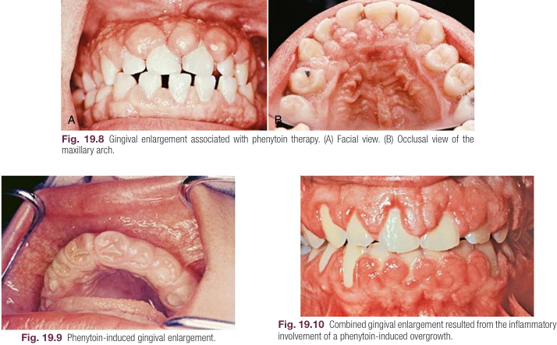

Slide 22
Calcium Channel Blockers
Calcium channel blockers are a group of drugs commonly used to treat hypertension, angina pectoris, coronary artery spasm, and cardiac arrhythmia.
Benzothiazepine derivatives (diltiazem),
phenylalkylamine derivatives (verapamil),
dihydropyridines (amlodipine, felodipine, isradipine, nicardipine, nifedipine, nitrendipine, oxodipine, nimodipine, and nisoldipine)
They have all been associated with some degree of DIGO

Slide 23
Prevalence of nifedipine induced GO is highly variable, ranging from 6% to 83% of patients taking the medication.
Clinically, interdental papilae are affected, and overgrowth is limited to attached and marginal gingiva, usually observed on the anterior segments.
Nifedipine induced GO may be accompanied by periodontitis and attachment loss differing from other forms of DIGO.

Slide 24
Immunosuppressants
Cyclosporine A has been used as the immunosuppressant of choice to prevent rejection of solid organ transplants, bone marrow transplantation, and treatment of autoimmune conditions.
The prevalence of cyclosporine A induced GO has been around 30%, while this number can reach much higher, especially in pediatric populations.
Clinically, the lesions are more inflamed and bleed more than other DIGO forms and are frequently limited to buccal surfaces.

Slide 25
Histopathology
Phenytoin present a thick stratified squamous epithelium with long thin rete pegs extending deep into the connective tissue.
Fibrosis is a common finding in these patients with minimal inflammatory cell infiltration.
The histologic characteristics of GO induced by calcium channel blockers are similar to phenytoin-induced lesions, but differs in histological attachment loss due to the accompanying periodontitis .

Slide 26
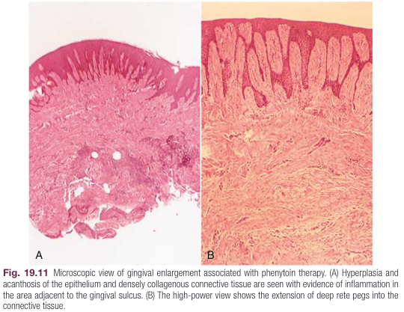

Slide 27
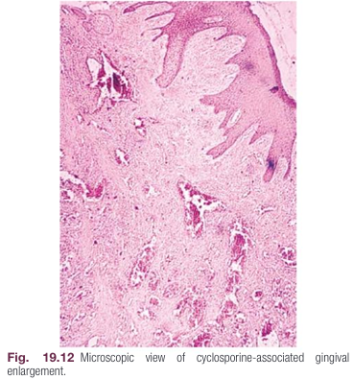
Cyclosporin A induced GO also manifests with a thickened epithelium, rete peg formation, and irregular collagen fibers.
These lesions, however, are characterized by more inflammatory infiltration and vascularization compared with DIGO associated with phenytoin and calcium channel blockers.

Slide 28
Treatment
The most effective treatment of DIGO is withdrawal or substitution of medications leading to the resolution of gingival lesions in 1 to 8 weeks after discontinuing the medication.
Changing nifedipine to another antihypertensive drug, isradipine, caused regression of gingival enlargement.
Tacrolimus, used as an alternative for cyclosporin A, resulted in the reversal of gingival enlargement.
scaling and root planing reduces the severity of the clinical presentation of GO.

Slide 29
Nonsurgical treatment can eliminate the inflammatory component of DIGO, reducing the extent and need for surgical intervention.
Because the anterior labial gingiva is frequently affected, surgery is commonly performed to solve esthetic and functional problems.
Surgical elimination of DIGO lesions involves gingivectomy and gingivoplasty.
it is the treatment of choice in DIGO after the phase I periodontal treatment.
The recurrence rate is high.

Slide 30
Gingival Overgrowth Associated With Systemic Conditions
The causes and clinical features of GO associated with systemic conditions are diverse and usually manifest with amplification of existing biofilm induced inflammation.
These gingival pathologies are conditioned enlargements and include lesions related to hormonal and nutritional etiologic factors.

Slide 31
Pregnancy Associated Gingival Overgrowth
Clinical Manifestations
GO is a common feature in pregnancy
Clinically, it manifests as a single mass or multiple tumor like masses at the gingival margin
These lesions can be observed as single enlargements, which are referred to as pregnancy tumors
Pregnancy tumors are not neoplasms; they represent an inflammatory response to microbial plaque modified by the patient’s altered host response
It usually appears after the third month of pregnancy, but it may occur earlier.

Slide 32
Enlargement is usually generalized, but it tends to be more prominent interproximally than facial and lingual surfaces.
The enlarged gingiva is bright red or magenta, soft, and friable, with a smooth and shiny surface.
Bleeding occurs spontaneously or on slight provocation.

Slide 33
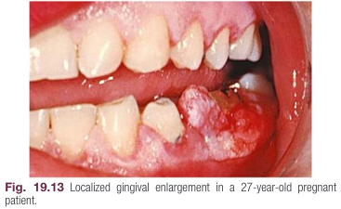
The lesion appears as a discrete, mushroom like, flattened spherical mass that protrudes from the gingival margin or, more often, from the interproximal space.
It tends to expand laterally, and pressure from the tongue and the cheek perpetuates its flattened appearance.

Slide 34
The superficial lesion of pregnancy associated GO usually does not invade the underlying bone.
The mass is generally firm, but it may have various degrees of softness and friability.
It is typically painless unless its size and shape foster the accumulation of debris under its margin or interfere with occlusion, in which case painful ulceration may occur.

Slide 35
Etiology
progesterone and estrogen levels increase 10 to 30 times by the end of the third trimester compared with the menstrual cycle.
it is thought that these hormonal changes induce an increased vascular permeability, which leads to gingival edema and an increased inflammatory response to dental plaque.

Slide 36
Histopathology
Gingival enlargement in pregnancy angiogranuloma
vascular changes and fibrotic process Marginal and tumor like enlargements
consist of a central mass of connective tissue, with numerous diffused, newly formed, and engorged capillaries and a moderately fibrous stroma with various degrees of edema and chronic inflammatory infiltrate.
In addition, the stratified squamous epithelium is thickened, with prominent rete pegs and some degree of intracellular and extracellular edema and leukocytic infiltration.

Slide 37
Treatment
GO lesions can be prevented by good oral hygiene in most cases.
Severe cases may require surgical excision during the second trimester;
the spontaneous reduction in the size of gingival enlargement typically follows the termination of pregnancy,
complete elimination of the residual inflammatory lesion and GO requires removal of all plaque deposits, elimination of factors that favor its accumulation, in some fibrotic cases, surgical intervention after the pregnancy.

Slide 38
Puberty Associated Gingival Overgrowth
Clinical Manifestations
The lesions are not specific to any gender; both male and female adolescents may develop puberty associated GO.
Clinically, there is a strong association with biofilm accumulation.
The lesions are usually marginal and interdental, and they are characterized by prominent bulbous interproximal papillae.
Often, only the facial gingivae are enlarged, and the lingual surfaces are relatively unaltered.

Slide 39
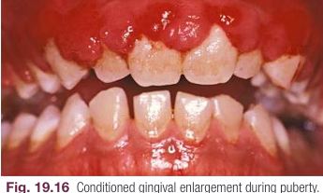

Slide 40
Etiology
Gingival enlargement during puberty has all the clinical features that are associated with the chronic inflammatory gingival disease.
The degree of growth and its tendency to recur in the relatively scant plaque deposits distinguish puberty associated GO from purely gingivitis associated lesions, suggesting a profound impact on hormonal changes.

Slide 41
Histopathology
The microscopic appearance of gingival enlargement during puberty is one of chronic inflammation with prominent edema.
It cannot be distinguished from other forms of gingivitis associated GO lesions.
Treatment
After puberty, enlargement undergoes spontaneous reduction, but it may not disappear completely until the plaque and calculus are removed.

Slide 42
Nutrition Associated Gingival Overgrowth
Malnutrition has been historically associated with several oral lesions.
GO has been observed in cases of chronic vitamin C deficiency in patients with scurvy.
Clinical Manifestations
Gingival enlargement with vitamin C deficiency is marginal.
The gingiva is bluish red, soft, and friable, and it has a smooth, shiny surface.
Bleeding that occurs spontaneously or on slight provocation, and surface necrosis with pseudomembrane formations are common features.

Slide 43
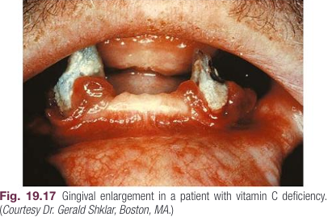

Slide 44
Etiology
Acute vitamin C deficiency alone does not cause gingival inflammation, but it does cause hemorrhage, collagen degeneration, and edema of the gingival connective tissue.
These changes modify the response of the gingiva to biofilm to the extent the extent of the inflammation is exaggerated.

Slide 45
Treatment
Nutrition-associated GO lesions are rare.
Changes in nutrition accompanied by nonsurgical treatment and good oral hygiene usually result in complete resolution of the pathology.
However, in rare cases, surgical removal may be indicated.

Slide 46
Gingival Fibromatosis
Clinical Manifestations
Gingival fibromatosis (GF) can be hereditary or idiopathic.
These lesions are rare and occur in highly fibrotic forms of GO.
Hereditary gingival fibromatosis (HGF) is the most common form, and it has been linked to several genetic loci.
Idiopathic gingival fibromatosis (IGF) is a rare condition of undetermined cause, likely driven by yet to be discovered genetic defects or physiologic changes.

Slide 47
GF affects the attached gingiva, the gingival margin, and the interdental papillae.
the facial and lingual surfaces of the mandible and maxilla usually are affected, but the involvement may be limited to either jaw.
The fibrotic gingiva is pink, firm, and almost leathery, and it has a characteristic minutely pebbled surface.
The teeth are almost completely covered in severe cases and the enlargement projects into the oral vestibule.
Secondary inflammatory changes are common at the gingival margin.

Slide 48
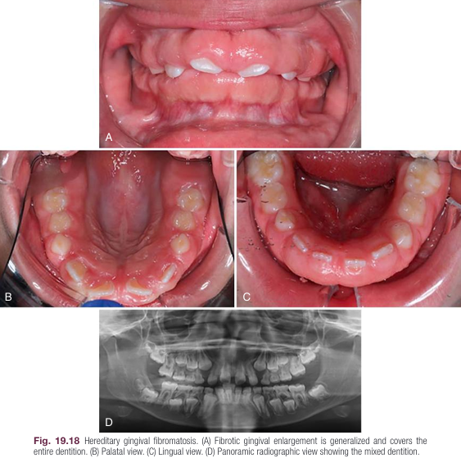

Slide 49
The enlargement usually begins with the eruption of the primary or permanent dentition.
the teeth or the biofilm may be initiating factors.
The presence of bacterial plaque is a complicating factor.

Slide 50
Histopathology
GF presents with highly fibrotic lesions, with a bulbous increase in connective tissue that is relatively avascular and consists of densely arranged collagen bundles and numerous fibroblasts.
The surface epithelium is thickened and acanthotic, with elongated rete pegs.
Histopathology is similar to phenytoin-induced GO with low levels of inflammatory infiltration.

Slide 51
Treatment
Treatment of GO lesions manifesting as gingival fibromatosis requires gingivectomy and gingivoplasty.
In many cases, an underlying osseous growth accompanies the GF, which requires osteoplasty in addition to the gingivectomy and gingivoplasty.
Postsurgical clinical management is challenging because of the high recurrence rate.
The severity of lesions usually results in extreme crowding and misalignment of teeth.
After removal of the fibromatosis lesions, patients may require orthodontic treatment and a meticulous oral hygiene program.

Slide 52
Other Forms of Gingival Enlargement
The gingiva can be enlarged due to increases in the size of the underlying osseous and dental tissues.
These false enlargements usually have no abnormal clinical features except for the massive increase in the size of the area.
For example, enlargement of the bone subjacent to the gingival area occurs most often with tori and exostoses.
Still, it can also occur with Paget disease, fibrous dysplasia, cherubism, central giant cell granuloma, ameloblastoma, osteoma, and osteosarcoma.

Slide 53
during the various stages of the eruption, particularly of the primary dentition, the labial gingiva can have a bulbous marginal distortion caused by the superimposition of the bulk of the gingiva on the normal prominence of the enamel in the gingival half of the crown.
This enlargement is called developmental enlargement, and it often persists until the junctional epithelium has migrated from the enamel to the cementoenamel junction.
developmental gingival enlargements are physiologic, and they usually present no problems for patients.
However, when the enlargement is complicated by marginal inflammation, the composite picture gives the impression of extensive gingival enlargement

Slide 54
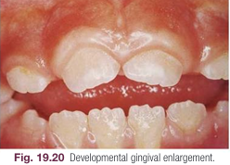

Slide 55
Epulis
Epulis is a generic term used to clinically designate all discrete tumors and tumor like masses of the gingiva.
It serves to locate the tumor but does not describe it.
Most lesions referred to by this term are inflammatory rather than neoplastic.
For example, fibromas arise from the gingival connective tissue or the periodontal ligament.
In another variant, mineralized tissue (i.e., bone, cementum-like material, and dystrophic calcifications) can be found; this type of fibroma is called peripheral ossifying fibroma.

Slide 56
Peripheral giant cell granulomas of the gingiva arise interdentally or from the gingival margin.
They occur most frequently on the labial surface, and they can be sessile or pedunculated.
They vary in appearance from smooth, regularly outlined masses to irregularly shaped, multilobulated protuberances with surface indentations.
Ulceration of the margin is occasionally seen.
The lesions are painless, vary in size, and can cover several teeth.

Slide 57
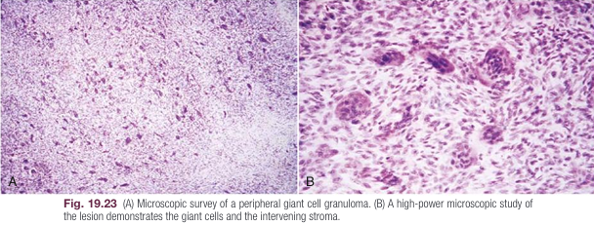
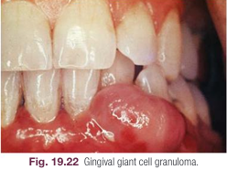
They can be firm or spongy, and their color varies from pink to deep red or purplish-blue.
Microscopic examination is required for definitive diagnosis.
In some cases, the giant cell granuloma of the gingiva is locally invasive and destroys the underlying bone.

Slide 58
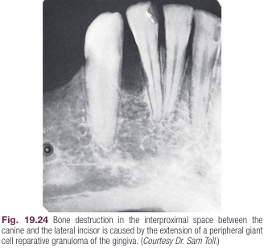

Slide 59
Squamous cell carcinoma (the most common malignant tumor of the gingiva).
Malignant melanoma (a rare oral tumor that tends to occur in the hard palate and maxillary gingiva of the elderly)
Fibrosarcoma, lymphosarcoma (the gingiva are rare)
Kaposi’s sarcoma (often occurs in the oral cavity, particularly in the palate and the gingiva, of patients with acquired immunodeficiency syndrome)
Tumor metastasis to the gingiva occurs infrequently

Slide 60
