Slide 1
Periodontitis

Slide 2
Definition of Periodontitis
Periodontitis complex inflammatory disease that affects the tooth supporting structures
Complex multiple clinical symptoms
multiple factors
Periodontitis occurs most frequently in adults
periodontitis should be understood as age associated, but not age dependent

Slide 3
systemic and environmental factors (e.g., diabetes mellitus, smoking) modify the host immune response to the dental biofilm so that the periodontal destruction becomes more progressive.
Periodontitis is a highly prevalent progressing disease
chronic non-communicable diseases
It affects approximately 10%, 5% up to 12% of the world population.

Slide 4
periodontitis slowly progressing disease
the presence of severe systemic conditions and/or environmental factors, such as smoking, this inflammatory disease progresses more rapidly.
The former classification described two different major forms of periodontitis, aggressive and chronic periodontitis,
aggressive periodontitis being defined as a rapidly progressing entity in systemically healthy subjects with a familiar aggregation.

Slide 5
General Characteristics and Symptoms
Characteristic clinical findings in patients with untreated periodontitis may include the following symptoms:
Supragingival and subgingival plaque (and calculus)
Gingival swelling, redness, and loss of gingival stippling
Altered gingival margins (rolled, flattened, cratered papillae, recessions)
Pocket formation
Bleeding on probing
Attachment loss

Slide 6
Bone loss (angular or horizontal)
Root furcation involvement
Increased tooth mobility
Change in tooth position
Tooth loss
The aforementioned signs and symptoms may all be simultaneously present or not.
However, the main symptom of periodontitis is the loss of attachment.

Slide 7
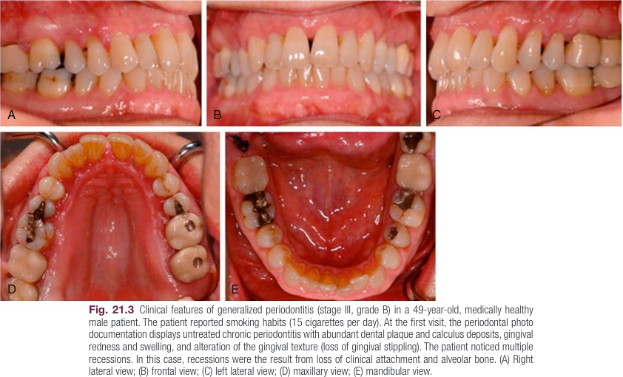

Slide 8
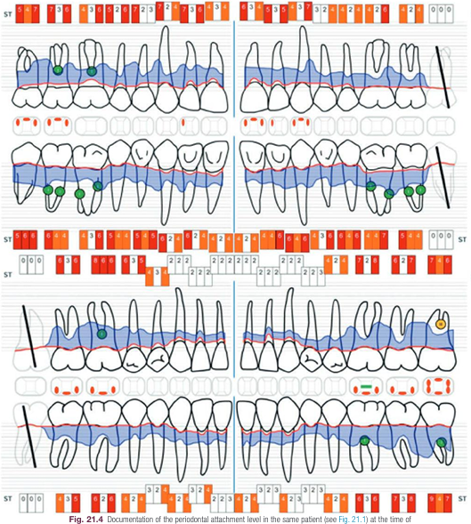

Slide 9
Documentation of the periodontal attachment level in the same patient at the time of the first visit. The red line displays the gingival margin reflecting recessions.
Clinical attachment loss is illustrated by the filled (blue) area on the root surfaces. The deepest periodontal pocket was measured with 9 mm.
Class I (green) and class II (yellow) furcation involvement were documented.
Bleeding upon periodontal probing (gingival inflammation) is reflected by red dots. Due to the history of smoking, the bleeding on probing score was relatively low, although the patient presented advanced attachment loss. Tooth mobility is indicated by the green line (tooth #19).

Slide 10
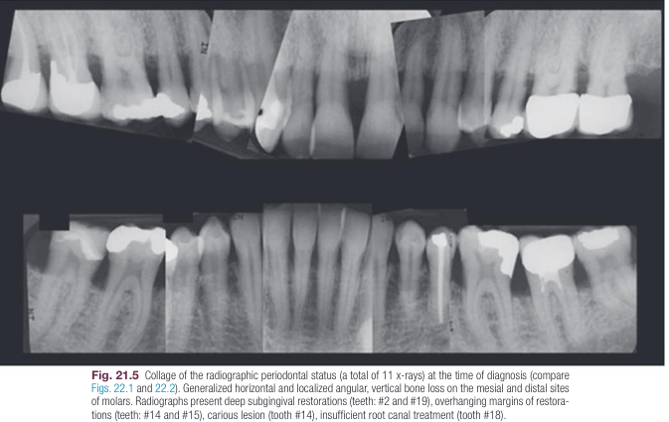

Slide 11
Periodontitis is commonly a slowly progressive complex disease without pain experience.
Therefore, most patients are unaware that they have developed a chronic disease.
gingival bleeding during oral hygiene procedures or eating may be the first sign of disease occurrence.
As a result of gingival recession, patients may notice black triangles between teeth tooth sensibility in response to temperature changes (cold and heat)

Slide 12
food impaction may occur in the space of interdental triangles leading to increased patient discomfort and bad breath.
In cases with advanced attachment and bone loss, tooth mobility, tooth movement, fanned out or elongated front teeth, and, tooth loss may be reported.
In those cases with advanced disease progression, areas of localized dull pain or pain sensations radiating to other areas of the mouth and/or head may occur.

Slide 13
Systematic Diagnosis Staging and Grading
systematic approach to defining both the disease phenotype (staging) and the disease progression (grading).

Slide 14
staging
severity, complexity, distribution
Periodontitis is, not considered as a disease that affects one single site in the dentition.
the diagnosis of a certain stage of periodontitis may only reflect a transient stage during disease progression at the examination time-point.
If no treatment is provided to the patient, a higher stage of periodontitis will most likely be diagnosed at the time of re-examination several years later

Slide 15
Severity of Periodontitis
In most cases, the severity and extent of periodontal destruction occur over time in combination with systemic disorders impairing and/or enhancing host immune responses.
Relative to the degree of attachment and bone loss, disease severity is described by the definition of disease stages.

Slide 16
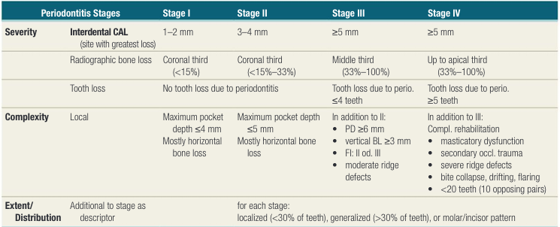

Slide 17
For stages I and II, no teeth should be missing or tooth loss occurred due to other reasons besides periodontitis such as caries, or traumatic or endodontic complications.
If ≤4 or ≥5 teeth were lost due to periodontitis, a stage III or IV, respectively, needs to be considered:
Stage I and II: no tooth loss due to periodontitis;
• Stage III: ≤4 teeth lost due to periodontitis;
• Stage IV: ≥5 teeth lost due to periodontitis.

Slide 18
Complexity of Periodontitis
Complexity factors are defined to further differentiate between stages of periodontitis.
To describe disease complexity, the following local parameters need to be determined:
probing pocket depth (PPD), furcation involvement (FI), horizontal and vertical BL, tooth mobility, mastication function, and ridge defects.

Slide 19
With respect to the complexity factors, stage I and stage II are differentiated by PPD, while a horizontally destroyed alveolar bone is characteristic for both stages:
• Stage I: PPD ≤4 mm, mostly horizontal BL;
• Stage II: PPD ≤5 mm, mostly horizontal BL.
differentiation between stage III and IV is not possible solely based on severity factors.
Thus, complexity factors eventually allow for clear differentiation.

Slide 20
Stage III:
• PPD ≥6 mm;
• Vertical bone loss ≥3 mm;
Furcation involvement: class II or III;
• Moderate ridge defects.
stage IV
In addition to stage III, those factors are:
• Masticatory dysfunction;
• Secondary occlusal trauma;
• Severe ridge defects;
• Bite collapse;
• Drifting;
• Flaring;
• Less than 20 remaining teeth (or 10 opposing pairs)

Slide 21
Disease Distribution
Periodontitis exhibits a site specific clinical picture, where attachment and bone loss are not equally distributed throughout the entire dentition as well as around teeth.
periodontitis may show a localized or a generalized distribution pattern.
Localized periodontitis: <30% of teeth show attachment and bone loss.
Generalized periodontitis: >30% of teeth show attachment and bone loss.

Slide 22
In young patients without restorations, periodontal bone loss most likely occurs interproximally at first incisors and/or first molars.
This phenomenon of a molar/incisor pattern indicates early disease onset, and it has been defined as localized juvenile periodontitis in former versions of the classification of periodontal diseases and conditions (Grade C).

Slide 23
Disease Progression Grading
Periodontitis may develop at any time in life.
In most cases, the progression rate of periodontitis is slow so that symptoms of the disease appear around the age of forty or later in life.
Onset and the rate of disease progression, however, may be influenced by a number of different modifiable (e.g., smoking) and non-modifiable (e.g., genetic disorders) factors.
patients that develop a metabolic disorder, such as diabetes mellitus, may exhibit a much higher progression rate of periodontitis along with increased alveolar bone loss, periodontal bleeding, and pocketing.

Slide 24
The progression pattern of periodontitis does not show equal degrees of attachment loss on each affected site over time.
disease progression is more rapidly at interproximal sites compared to oral or buccal areas of neighboring teeth.
The grading procedure allows for the determination of periodontal disease progression.
The systematic grading procedure requires evaluation of the primary criteria for direct and indirect evidence of disease progression as well as identification of grade modifiers.

Slide 25
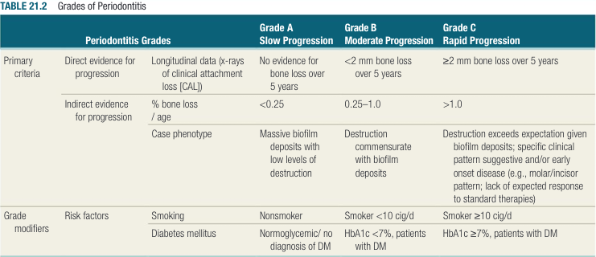

Slide 26
Risk Factors Modification of Grades
The composition of the oral microflora and the amount of dental biofilm (plaque) is a major etiologic factor.
The extent of the periodontal destruction depends on the host’s immune competence as well as genetic predispositions influencing the individual susceptibility to disease.

Slide 27
Microbiological Aspects
Attachment and bone loss are associated with an increase in the proportion of gram negative organisms in the subgingival biofilm, with specific increases in organisms known to be pathogenic and virulent.
Porphyromonas gingivalis, Tannerella forsythia, and Treponema denticola, otherwise known as the “red complex” bacteria, are frequently associated with ongoing attachment and bone loss in chronic periodontitis.

Slide 28
Smoking
Smoking is a major risk factor for the development and progression of periodontitis.
Periodontitis is influenced by smoking in a dose dependent manner.
The intake of more than 10 cigarettes per day tremendously increases the risk of disease progression when compared to nonsmokers and former smokers.
tobacco smoking not only increases the susceptibility to periodontitis but also contributes to a poorer response to periodontal therapy.

Slide 29
Compared to nonsmokers, the following features are found in smokers:
• increased periodontal pocket depth with more than 3 mm
• increased attachment loss
• more recessions
• increased loss of alveolar bone
• increased tooth loss
fewer signs of gingivitis (less bleeding upon probing)
• greater incidence of furcation involvement

Slide 30
Diabetes Mellitus
Periodontitis is known as the sixth complication of diabetes mellitus.
It is known that there is an interaction where both diseases mutually correlate to each other.
higher risk to develop periodontitis
the periodontal infection/inflammation may negatively interfere with the glycemic control of the diabetic patient
the average pocket depth as well as the clinical attachment loss was increased in patients with diabetes mellitus.

Slide 31
Patients with poor glycemic control tend to experience more severe progression of periodontitis compared to patients with good glycemic control.
With diabetes mellitus, advanced glycation end products (AGEs) may arise which lead to the release of free oxygen and pro inflammatory mediators (cytokines).
AGEs may also promote chemotaxis and adhesion of inflammatory cells to periodontal tissues, and increased apoptosis of fibroblasts and osteoblasts may occur.

Slide 32
Periodontal therapy may contribute to the glycemic control of the diabetic patient.
It was shown that the systematic therapy of chronic periodontitis leads to a at least short term reduction of glycated hemoglobin of approximately 0.3% up to 0.6% (HbA1c).

Slide 33
Immunologic Factors
The onset, progression, and severity of the disease depend, on the individual host immune response.
Patients may show alterations of peripheral monocytes which relate to reduced reactivity of lymphocytes and/or enhanced B-cell response.
Not only B-cells and macrophages, but also periodontal ligament cells, gingival fibroblasts, and epithelial cells synthesize pro-inflammatory mediators, such as interleukin-1 beta (IL-1 beta), IL-6, IL-8, prostaglandin-E2 (PGE2), tumor necrosis factor alpha (TNF-alpha), that modify innate and adaptive immune responses at periodontal sites.

Slide 34
Pro inflammatory mediators regulate the synthesis and secretion of matrix metalloproteinases (MMPs) and receptor-activator-of-NF-kappaB-ligand (RANKL).
In periodontal lesions, MMPs contribute to soft and hard tissue degradation during active inflammatory reactions.
RANKL binds to its receptor RANK on the cell surface of premature osteoclasts, and therewith, initiates osteoclast differentiation leading to degradation of alveolar bone.

Slide 35
reduced counts in neutrophils (PMNs) influence the degree of periodontal inflammation.
Congenital neutropenia (Kostmann syndrome) leads not only to an increased susceptibility to infection in general but also to severe periodontitis.
Patients with Kostmann syndrome show reduced levels of antimicrobial peptides, such as the cathelicidin, which impair their innate immune response.

Slide 36
Genetic Factors
Periodontitis is considered as a complex inflammatory disease influenced by local, systemic, and immunologic factors.
Each factor is in turn directly related to individual genetic conditions.
Several genetic disorders are known to show periodontal destruction as one of their major symptoms.
contribute to the severity and progression of periodontitis (Papillon Lefèvre syndrome; Haim-Munk syndrome, Ehlers Danlos syndrome, Down syndrome, Kindlers syndrome, Cohen syndrome, and congenital neutropenia (Kostmann syndrome).

Slide 37
Early twin studies suggested the involvement of genetic susceptibility factors in the etiopathogenesis of periodontitis.
In a number of studies, the prevalence of aggressive and chronic periodontitis has been investigated in families with a history of one or more family members with periodontitis.
The data from those studies showed variable results with a likelihood for heritability of up to 50%.

Slide 38
(single nucleotide polymorphisms, SNPs) that may also directly influence innate and adaptive immune responses as well as the structure of periodontal tissues.
Studies on SNPs in the IL-1 gene led to the early that alterations in sequences of immunologically relevant genes may explain the heritability of periodontitis
Conflicting data in the literature, however, indicate inconclusive knowledge regarding SNPs in the IL-1 gene and their potential role during heritability and etiopathology of periodontitis.

Slide 39
Also, it seems not plausible that one single polymorphism in a specific gene sequence can cause a complex inflammatory disease, such as periodontitis.
Thus, genome-wide association studies (GWAS) became more relevant in the past years. Here, a high number of DNA-sequence variances are evaluated at the same time.

Slide 40
In several GWAS, a number of new genes have been identified to be associated with periodontitis.
One of the best-replicated genes is called ANRIL (antisense RNA in the Inc locus).
ANRIL is not only associated with periodontitis but also with cardiovascular disease which underlies potential systemic interactions.

Slide 41
Other Factors
Psychological factors, such as stress and depression, also negatively influence the progression of periodontitis.
Positive correlations between cortisol levels and periodontal indices (plaque index, gingival index), bone loss, and missing teeth were recorded.
In addition, stress as an etiologic factor was even stronger associated with periodontitis when patients were smokers compared to nonsmokers.

Slide 42
دو مثال از بیماریهای لثه وابسته به پلاک و غیر وابسته به پلاک بنویسید؟

Slide 43
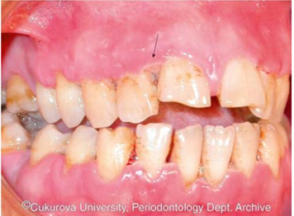
What is your diagnosis؟
25 year old man
chief complaint: pain, fever, bleeding on provocation

Slide 44
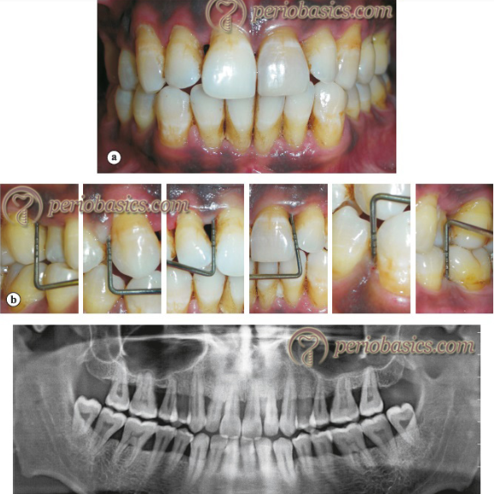
35 years old male
CAL >5 mm
diagnosis?

