Slide 1
Radiographic Aids in the Diagnosis of Periodontal Disease
Newman and Carranza's Clinical Periodontology and Implantology 14e
CHAPTER 39

Slide 2
Radiologic imaging provides essential information that contributes to diagnosis and management of patients with periodontal disease.
Thus radiographs must be used as an adjunct to and not as a substitute for a clinical examination.
Radiologic evaluation provides information on the morphology of intrabony defects, the extent of furcation bone loss, and anatomic restrictions to root instrumentation factors that contribute to treatment planning and outcome.
In addition, radiographs provide longitudinal assessment of bone loss.

Slide 3
Radiographic (periodontal) bone loss (RBL) reflects cumulative bone resorption from current and prior inflammation and must be interpreted in the context of the patient’s periodontal history and current clinical presentation.
Periodontal health cannot be determined by radiologic evaluation alone.

Slide 4
Imaging Modalities for Periodontal Assessment
Intraoral Imaging
Intraoral radiologic imaging with periapical and bite wing projections serves as the primary imaging examination to assess periodontal disease.
Radiologic assessments include evaluation of the bone level, the destruction pattern, periodontal ligament (PDL) space width, and the radiodensity, trabecular pattern, and marginal contour of the interdental bone.

Slide 5
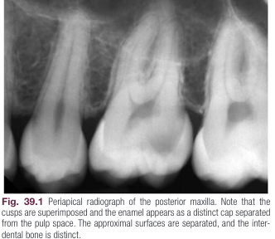
Prichard established the following four criteria to determine adequate angulation of periapical radiographs:
1. The radiograph should show the tips of molar cusps with little or none of the occlusal surface showing.
2. Enamel caps and pulp chambers should be distinct.
3. Interproximal spaces should be open.
4. Proximal contacts should not overlap unless teeth are anatomically misaligned.

Slide 6
For periapical radiographs, the long cone paralleling technique accurately projects the alveolar bone level.
The bisecting angle technique typically elongates the projected image, making the bone margin appear closer to the crown; the facial bone level is distorted more than the lingual alveolar crest.

Slide 7
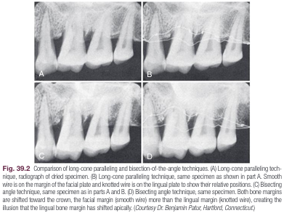

Slide 8
Periapical radiographs frequently do not reveal the correct relationship between the alveolar bone and the cementoenamel junction (CEJ).
This is particularly true when a shallow palate or high floor of the mouth does not allow ideal placement of the receptor parallel to the tooth.
Bite wing radiographs are a better approach to evaluate periodontal bone levels.
the bite-wing projection geometry permits evaluation of the relationship between the interproximal alveolar crest and the CEJ without distortion.

Slide 9
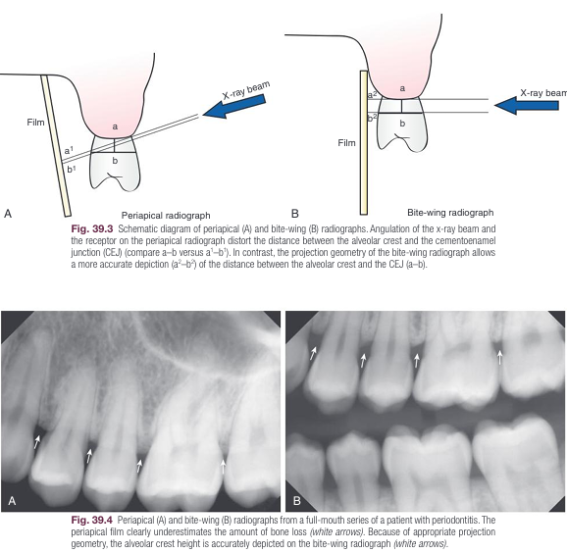

Slide 10
Bite wing imaging is the preferred technique to depict interdental bone levels in the posterior dentition.
In addition, vertical bite wing radiographs are preferred when periodontal bone loss is severe.

Slide 11
Panoramic Imaging
panoramic image resolution is lower than that of intraoral radio graphs, and assessments of root shape and resorption are more accurate on intraoral radiographs.

Slide 12
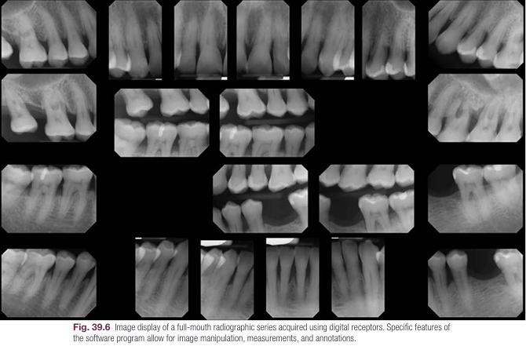
A full mouth intraoral radiographic survey is the examination of choice for initial evaluation of patients with generalized periodontal disease or with a history of extensive dental restorations.

Slide 13
CBCT
CBCT imaging is superior to intraoral imaging for identification of interdental craters, furcation involvement, and dehiscence and fenestration defects.
Despite these demonstrated advantages, an American Academy of Periodontology Best Evidence Review found limited evidence to justify CBCT imaging for routine diagnosis and treatment planning of moderate-to-severe (stage II, III, or IV) periodontitis.

Slide 14
Normal Interdental Bone
Standard radiologic assessments for periodontal disease use intra oral radiographs.
evaluation of bone changes in periodontal disease is based predominantly on the appearance of the interdental bone.
The boundaries of the interdental bone are the cortical outlines of the tooth socket and the alveolar crest.
The tooth socket appears as a thin, radiopaque line adjacent to the PDL and is referred to as the lamina dura.
The cortical bone at the alveolar crest is also depicted as a thin radiopaque line between adjacent teeth.

Slide 15
The width and shape of the interdental bone and the angle of the crest normally vary with the convexity of the proximal tooth surfaces and the relative levels of the cementoenamel junction (CEJ) of the approximating teeth.
The dimension of the interdental bone is determined by the width of the proximal root surface and space between approximal teeth.
In the anterior dentition, the interproximal spaces are narrower, and the interdental bone is triangular in shape.
In the posterior dentition, the crestal table of the interdental bone appears as a corticated line parallel to a line between the CEJs of the approximating teeth and approximately 1 to 2 mm below this line.

Slide 16
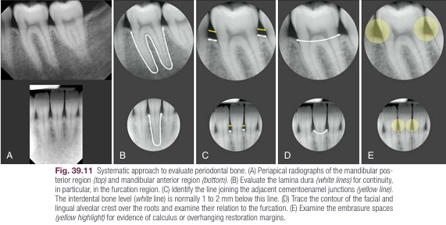

Slide 17
Radiographic Appearance of Periodontal Disease
Early destructive changes of bone that do not remove sufficient mineralized tissue cannot be captured on radiographs.
Therefore radiographic manifestations suggest that the disease has progressed beyond its initial stages.
The earliest signs of periodontal disease must be detected clinically.
Radiographic changes of periodontal inflammation follow the pathophysiology of periodontal tissue destruction and include the following:

Slide 18
1. Fuzziness and disruption of lamina dura and crestal cortication are the earliest radiographic changes of periodontitis and results from bone resorption activated by extension of gingival inflammation into the periodontal bone. Depicting these early changes depends greatly on the radiographic technique and on anatomic variations (thickness and density of interdental bone, position of adjoining teeth).
2. Continued periodontal bone loss and widening of the periodontal space results in a wedge shaped radiolucency at the mesial or distal aspect of the crest. The apex of the area is pointed in the direction of the root.

Slide 19
3. the destructive process extends across the alveolar crest, reducing the height of the interdental bone. As increased osteoclastic activity results in increased bone resorption along the endosteal margins of the medullary spaces, the remaining interdental bone may appear partially eroded.
4. The height of the interdental septum is progressively reduced by the extension of inflammation and the resorption of bone.

Slide 20
5. Frequently a radiopaque horizontal line can be observed across the roots of a tooth.
This opaque line demarcates the portion of the root where the labial or lingual bony plate has been partially or completely destroyed from the remaining bone supported portion.

Slide 21
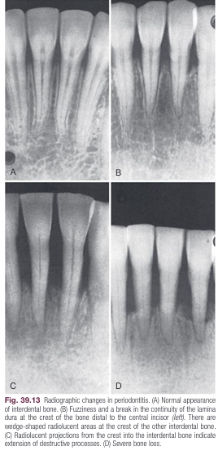
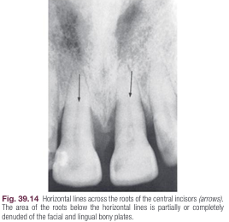

Slide 22
Radiographic Bone Loss
Bone loss is the final manifestation of the periodontal inflammatory process.
The radiographic image tends to underestimate the severity of bone loss.
The difference between the alveolar crest height and the radiographic appearance ranges from 0 to 1.6 mm, mostly accounted for by x-ray angulation.

Slide 23
Radiologic assessment of bone loss must include both the amount of bone loss and the distribution and pattern of bone destruction.
The amount of bone lost is estimated to be the difference between the physiologic bone level and the height of the remaining bone.
Several investigators have analyzed the distance from the CEJ to the alveolar crest—it is generally accepted that the alveolar crest is less than 2 mm from this reference line.

Slide 24
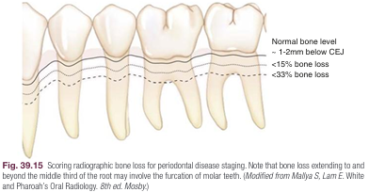

Slide 25
Patterns of Bone Destruction
Periodontal bone loss changes the height and contour of the bone. The patterns of bone destruction are broadly categorized as horizontal bone loss and vertical or angular defects.
In horizontal bone loss, the height of interdental bone is reduced with the crest perpendicular to the long axis of the adjacent teeth.
In contrast, vertical or angular defects are oblique troughlike bone loss adjacent to the root surface, with base of the defect located apically.
The defects are classified as one, two, or three-wall defects, depending on the number of bony walls that surround the defect.

Slide 26
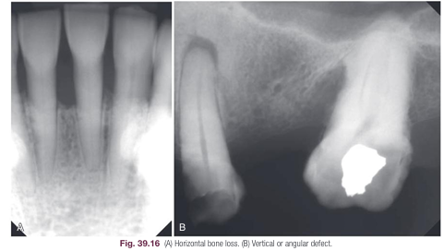

Slide 27
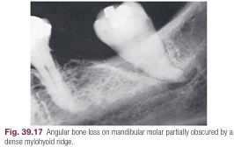
The internal morphology and depth of vertical defects are not apparent on two-dimensional radiographs.
Bone destruction of facial and lingual surfaces is masked by the dense root structure, and bone destruction on the mesial and distal root surfaces may be partially hidden by superimposed anatomy, such as a dense mylohyoid ridge.

Slide 28
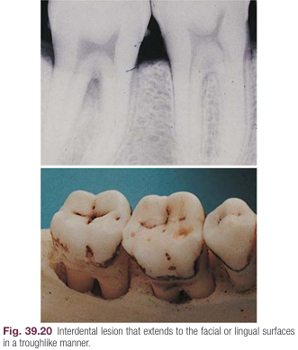
In most cases, it can be assumed that bone loss seen interdentally continues in either the facial or lingual aspect, creating a troughlike lesion.
Bone loss along the facial and lingual alveolar crest is apparent on CBCT examination, best visualized on cross-sectional images.

Slide 29
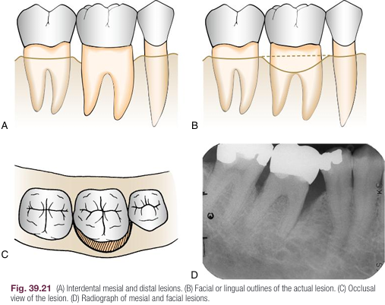
shows two adjacent interdental lesions connecting on the radicular surface to form one interconnecting osseous lesion.

Slide 30
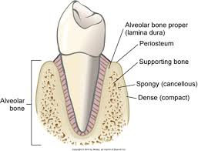
Interdental craters
Dense cortical facial and lingual plates of interdental bone obscure destruction of the intervening cancellous bone.
To record destruction of the interproximal cancellous bone radiographically, the cortical bone must be involved.
A reduction of only 0.5 to 1 mm in the thickness of the cortical plate is sufficient to permit radiographic visualization of the destruction of the inner cancellous trabeculae.

Slide 31
Interdental craters are a specific type of two-wall defect they are concavities in the interdental bone between the facial and lingual plates.
Interdental craters are common manifestations of periodontal destruction and constitute a third of osseous defects.
They are more common in the mandible, especially in the posterior regions.
Radiographically, interdental craters are recognized as irregular areas of reduced density on the alveolar bone crests.

Slide 32
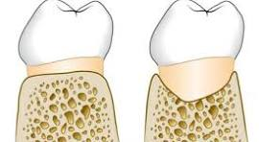
Craters are generally not sharply demarcated but gradually blend with the rest of the bone.
Conventional radiographs do not accurately depict the morphology or depth of interdental craters, which sometimes appear as vertical defects.
CBCT imaging allows for better evaluation of the three-dimensional morphology of the defect.

Slide 33
Furcation Involvement
Definitive diagnosis of furcation involvement is made by clinical examination, which includes careful probing with a specially designed probe (e.g., Nabers).
Radiographs are helpful, but root superimposition, caused by anatomic variations or improper technique, can obscure bone loss in the furcation.
Radiographs should be taken at different angles to reduce the risk of missing furcation involvement.

Slide 34
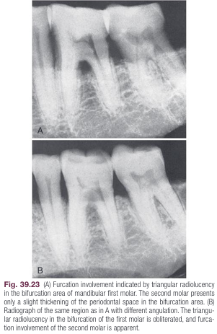

Slide 35
To assist in the radiographic detection of furcation involvement, the following evaluation scheme is suggested:
1. The slightest radiographic change in the furcation area should be investigated clinically, especially if there is bone loss on adjacent roots.
2. Diminished radiodensity in the furcation area in which outlines of bony trabeculae are visible suggests furcation involvement.
Whenever there is marked bone loss in relation to a single molar root, it may be assumed that furcation is also involved.

Slide 36
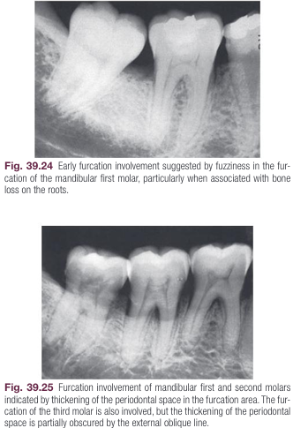

Slide 37
Periodontal Abscess
The typical radiographic appearance of a periodontal abscess is a discrete area of radiolucency along the lateral aspect of the root.
This can be due to the following:
The stage of the lesion. The early stages of an acute periodontal abscess are extremely painful but present no radiographic changes.
The location of the abscess Lesions in the soft tissue wall of a periodontal pocket are less likely to produce radiographic changes than those deep in the supporting tissues.

Slide 38
Abscesses on the facial or lingual surface are obscured by the radiopacity of the root; interproximal lesions are more likely to be visualized radiographically.
Therefore radiographs alone cannot provide a final diagnosis of a periodontal abscess but need to be accompanied by careful clinical examination.

Slide 39
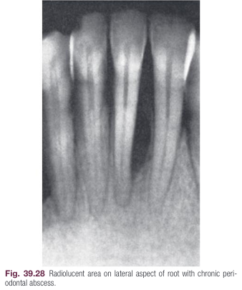
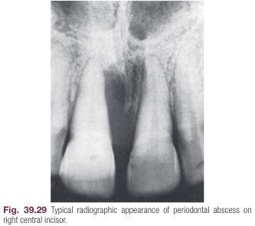

Slide 40
Localized Aggressive Periodontitis
In the 2018 disease classification, in addition to localized and generalized extent categories, “molar-incisor pattern” was added, which is now used to describe the previous disease category “localized aggressive periodontitis.”
As the name suggests, in this condition, the radiographic bone loss (mostly vertical) typically occurs in younger individuals and is restricted primarily to first molars and incisors.

Slide 41
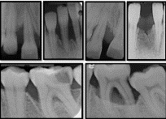

Slide 42
Trauma From Occlusion
Trauma from occlusion can produce radiographically detectable changes in the thickness of the lamina dura, morphology of the alveolar crest, width of the PDL space, and density of the surround ing cancellous bone.
The radiographic changes listed next are not pathognomonic for trauma from occlusion and must be interpreted in combination with clinical findings, particularly tooth mobility, presence of wear facets, pocket depth, and analysis of occlusal contacts and habits.

Slide 43
The injury phase of trauma from occlusion produces a loss of the lamina dura that may be noted in apices, furcations, and marginal areas.
This loss of lamina dura results in widening of the PDL space.
The repair phase of trauma from occlusion results in an attempt to strengthen the periodontal structures to better support the increased loads. Radiographically, this is manifested by a widening of the PDL space, which may be generalized or localized.

Slide 44
when seen on radiographs, variations in PDL space width suggest that the tooth is being subjected to increased forces.
Successful attempts to reinforce the periodontal structures by widening the PDL space can be accompanied by increased width of the lamina dura and sometimes by condensation of the perialveolar cancellous bone.

Slide 45
More advanced traumatic lesions may result in deep angular bone loss, which, when combined with marginal inflammation, may lead to intrabony pocket formation.
In terminal stages, these lesions extend around the root apex, producing a wide, radiolucent periapical image (cavernous lesions).
Root resorption may also result from excessive forces on the periodontium, particularly those caused by orthodontic appliances.
Although trauma from occlusion produces many areas of root resorption, these areas are usually of a magnitude insufficient to be detected radiographically.

Slide 46
